Slide 1
Our improvement plan 2020-2022

Slide 2
Contents
1
Introduction
Page | 03
2
Stories of success
Page | 04
3
We Care
Page | 10
4
Our approach to quality improvement
Page | 11
5
Our year 1 improvement plan
Page | 12
6
Governance Framework
Page | 28

Slide 3
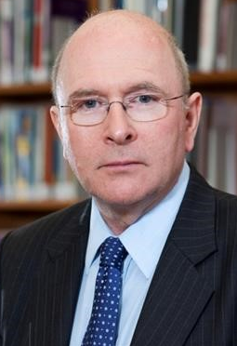
Introduction
Welcome to our two-year integrated improvement plan. This strategic plan, and the detailed work behind it to support its delivery, marks an important milestone in the Trust’s improvement journey and step change in the way we deliver quality improvement.
It sets out the key priorities for the Trust to ensure we focus on the right areas that will make the biggest difference for our patients and staff, and builds on the immediate changes we have made in key areas such as infection prevention and control, maternity and urgent and emergency care.
However, we know there is much more we need to do to consistently provide the excellent standard of care that we want across all our services, for every patient, every day; and to transform our culture to one of excellence and continuous improvement.
Our frontline staff are best placed to know what needs to change. We’ve seen success through initiatives like ‘Listening into Action’, ‘We said, we did’, ‘MediLead’ and ‘I can’ which released staff to make tangible, practical changes.
This plan and its approach describes how we will move from short-term initiatives to sustained continuous quality improvement, creating a golden thread running from ward to Board, with everyone equipped and understanding of their role in achieving it.
We recognise that this change in the way the Trust works means changing our behaviour and the way we do things. We will develop all leaders – from executive directors to ward managers – to be coaches, not ‘fixers’. We will live our Trust values in the way we work together, and involve patients in our improvement journey.
Frontline teams will drive agreed improvement actions, and be supported by the training, tools and consultation they need. Our Board will set the focus and our Executive Directors will coach leaders in how to enable change. Our corporate teams will work with frontline teams to facilitate organisation- wide improvements.
This plan sets out our strong commitment to continuous improvement, what we will do to achieve it and the difference it will make.
Niall Dickson
Chairman
Susan Acott
Chief Executive

Slide 4
An improvement plan to tackle challenges we have faced
East Kent Hospitals achieved University Hospital status in 2007 and became a foundation trust in 2009. Developments in services such as kidney care, earned the Trust a nationally-recognised reputation for delivering a number of high-quality specialist services. Yet the Trust has been through a challenging period in its history, in 2014 requiring support under “special measures” which provides increased levels of oversight and support from national and regional NHS teams to enable improvement.
The Trust’s Care Quality Commission (CQC) rating was upgraded in 2015 from “inadequate” to “requires improvement” as a result of “big steps forward” witnessed by the CQC. The Trust remained in special measures to allow more time to fully embed the improvements and in 2016 the Chief Inspector of Hospitals recommended that the Trust be taken out of special measures as a result of “further significant improvements” for local patients. This took place in March 2017, although the Trust remained in special measures to receive support to stabilise its finances.
Annual CQC inspections between 2015 and 2018 found areas of significant improvement and a number of areas of outstanding practice and innovation, for example, simulation training in maternity services, our use of technology, matron-led service changes and the launch of quality improvement “hubs”, led by front-line staff on each site. The dedication and caring nature of the Trust’s staff and areas of improved culture and leadership were also emphasised.
But the reports have continued to highlight areas where the Trust has still needed to make progress and this has also been the case in reports into individual services, for example, in children’s inpatient services following an inspection of the service in 2018; in maternity triage and day care following an inspection in January 2020, which also highlighted a number of improvements; in the emergency departments after an inspection in March 2020 and in infection prevention and control (IPC) practices following a focussed inspection in August 2020. The Trust has significantly improved its IPC performance by carrying out an extensive review of its IPC policies, processes and training.
The Trust has particular challenges for example its rural and coastal location in terms of recruitment; services spread across a number of sites leading to stretched rotas, an ageing estate and longer waiting lists than we would like. The Kent and Medway Medical School, long-term clinical strategy, innovation and research and rural strategy all aim to address these challenges.
We are also determined to continue to transform our maternity service into an excellent one for the 6,500 women and families who give birth every year. We are deeply sorry and apologise unreservedly for our failures which resulted in the death of baby Harry Richford in 2017, and to the other families we have failed by not providing the right care. We are working with some of the leading maternity experts in the country and are working closely with the independent investigation into maternity services in East Kent.
We have made significant improvements, particularly in areas which have benefitted from intense focus and investment. Some of those areas are described in the following pages. But we know we have much more to do. This improvement plan describes how we will focus on the changes that will make the biggest difference to our patients. We will also continue to seek the long-term investment needed to transform acute hospital care across East Kent, as set out in our strategy Transforming Health and Social Care in East Kent.

Slide 5
Stories of success Orthopaedics
East Kent Hospitals is taking part in a national Getting it Right First Time (GIRFT), a pilot to improve the experience and outcomes for patients. The initiative focus’ on patients undergoing planned orthopaedic inpatient operations and those patients suffering a trauma as a result of a fall or accident. Planned orthopaedic operations [and trauma rehabilitation wards] are centralised to create a centre of excellence on one hospital site.
The pain stole my independence and stopped me from doing things I love. I’m looking forward to getting my independence back so I can get myself to the shops, visit friends and relatives and get back to gardening.
Grace Williamson, 83, the pilot’s 1000th joint replacement patient, thanking hospital staff for giving her the chance of a new lease of life.
How
Challenge
Benefits
The Trust has secured almost £15 million investment to deliver four new operating theatres and 24 orthopaedics beds at the Kent & Canterbury Hospital.
The first orthopaedic inpatient operations are targeted in Spring 2021.
Taking part in the GIRFT pilot has required immense commitment and flexibility by clinical staff and their teams.
We have worked closely with the national lead Professor, Tim Briggs and the first phase of the pilot has proved to be very successful.
Between November 2018 and March 2020:
More than 2,200 patients had their planned lower limb operations sooner, including 1,300 patients who have had hip or knee replacements and almost 900 other routine lower limb operations.
Waiting times for knee replacements reduced by 6 weeks and nearly four weeks for hip replacements. The overall number of patients waiting for these operations reduced by almost 20%.
The freed up operating theatres at WHH resulted in 1,650 more patients having their trauma, gynaecology and general surgical operations sooner, as well as releasing an extra ward at WHH for patients with medical emergencies.

Slide 6
Stories of success Cancer
Over the past five years delivery of Cancer Waiting Times has been a challenge for East Kent Hospitals with some of the poorest achievement in the country.
The service now achieves the national waiting time targets for the key measures and as a result we are now part of the best performing Cancer networks in the country.
I had my first chemotherapy treatments in hospital but then they offered me the option of using the bus and now it’s invaluable.
I chose to carry on with my treatment during the pandemic and it makes me feel so much better being able to have it on the bus.
Like so many others, I have put my faith in the NHS to look after me and they absolutely are.
Mum, 48, and Cancer patient
How
Challenge
Benefits
This remarkable turnaround is due to a sustained and dedicated focus on continuous improvement, including tracking of over 37000 patients to ensure appointments, tests and results are undertaken as quickly as possible.
We were able to maintain almost all Cancer activity during the 2020 pandemic, this included carrying out some procedures at the Kent and Canterbury Hospital which we kept as Covid-free as possible, as well as using the independent sector and the mobile cancer unit.
Innovations included implementing prefilled prescriptions so cancer patients can present in Emergency Department (ED) and get the antibiotics they need quickly.
Virtual support clinics with Cancer nurse specialists supporting patients at home and highlighting any issues earlier.
All emergency cancer pathways were reviewed for consistency and equity
A 7 days Acute Oncology Service and 7 day Cancer Care line were launched to improve access to advice and support.
Over 36000 (97%) patients a year have been seen sooner for their 1st appointment with a cancer specialist or specialist test.
Over 3600 (98%) patients started their first treatment for cancer within 31 days of agreeing to their treatment plan.
Over 1900 (82%) patients started their first treatment within 62 days of a GP referral. And 88% for the last 4 months
88% of suspected Breast Cancer patients received their diagnosis within 28 days of referral.

Slide 7
Stories of success
Digital innovation
Time to recruit
Improvement training
Sunrise, the patient electronic health record (EHR) has replaced eCasCard in ED and the same electronic clinical record continues if patients are admitted, saving precious time. Information is shared and easily accessible, and patient care is enhanced.
In lockdown the Trust went from no video consultations to 450 consultants, nurses, therapist and midwives using this technology so patients could be seen.
As one of the first Trust’s to provide Covid testing and results in-house, we helped 25 organisations and introduced an online portal.
An electronic system meant millions of Personal Protective Equipment (PPE) items and use were recorded and distributed to ward level.
Time to recruit for agenda for change staff has been cut from 19 weeks in 2018 to 7 weeks following a complete overhaul of the recruitment process from start to finish.
It included a bringing in a new internal candidate process, a new software system, restructuring the Resourcing Team and the introduction of recruitment matrons.
This has led to a reduction in vacant posts, a better candidate experience, a streamlined initial recruitment process to save clinical staff time and more time to focus on other priorities including the recruitment of a record 160 international nurses in 2020.
In 2018 we introduced the KENT Methodology, a framework based in lean teachings to plan, design and deliver transformation and improvement. It has now been accredited by Cardiff University
Through the KENT Academy, the KENT Project, KENT Awareness, KENT Fundamentals and MediLead courses gave staff the knowledge and resources to create sustained changes in their own work areas, promoting quality, safety and productivity
For example, testing patients for allergic reactions for certain cancer drugs mitigated the risk of patients being admitted and joint GP/Paediatric clinics are providing children with more appropriate treatment.
Being able to bring new recruits on board quickly to fill gaps when team members move on makes a huge difference and reduces the impact on the remaining members of the team. It has saved money on back filling posts with agency staff and is great for new recruits excited to start their new jobs.”
“Being a part of the KENT Programme has given me the confidence in transferring knowledge, abilities, values and skills from one person to another in a format that is simple but effective.”
“Thank you for helping our trust make tangible changes to our attitudes and embracing change!”

Slide 8
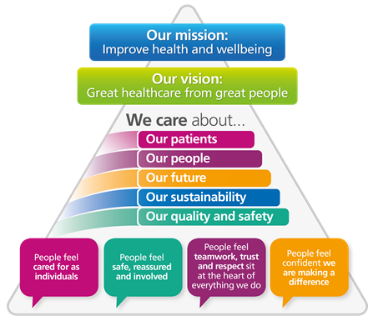
We Care Strategy deployment: creating clear focus
The We Care System is used to deploy a focused set of objectives to the Executive, corporate teams and frontline teams and asks them to focus on delivering a smaller set of important deliverables
Patient waiting time in Accident & Emergency (A&E)
Patient waiting time between referral and treatment
Responding to patient feedback
Our patients
Reduce harm to patients
Reduce mortality
Our quality & safety
Retaining our staff
Improve staff engagement
Our people
Patients only in the hospital if it’s the right place for them
Staff time released through innovation
Our future
Healthy finances
Reducing our carbon footprint
Our sustainability

Slide 9
Our approach to quality improvement
We have looked at how other organisations in the UK and internationally have approached long-term sustainable improvement which creates a golden thread running from ward to Board, with everyone focused on sustained and continuous improvement.
Our improvement programme “We Care”, aligns our strategy and goals across the entire organisation and empowers staff to make improvements by supporting them with the knowledge, tools and systems for managing improvement.
‘We care’ is how we’re working to give great care to every patient, every day. It’s about being clear about what we want to focus on and why, and supporting staff to make real improvements, by training, coaching and everyone using one, standard method to make positive changes.
Our true north
For ‘We care’ to be effective, we have chosen a small number of objectives (true north metrics), using data which shows us where we can make the most significant improvements by focusing our efforts.
The True north metrics are the ultimate guide of whether we are improving as an organisation. A focused set of “breakthrough” objectives are tied deliberately to improving these metrics. And we’ll also use data to measure how much we’re making a difference.
Achieving our goals requires an organisational mindset which means
Making ‘improvement’ a part of the daily work of all staff
Having systems, structures and behaviors that support an organisational culture of excellence
A critical success factor for We Care is that all improvement and management interventions are clearly and deliberately aligned in terms of what is done and how it is done.
Pre-Covid, we had begun a special journey – frontline staff leading real change for their patients in their areas, and sharing their ideas and good practice across the Trust.
It’s time to get back to re-start that journey – there’s lots we can do to improve standards at EKHUFT, the way we want to do it is by empowering and supporting front-line staff to make the changes they see are needed on the ground.
I want every member of staff to be able to feel proud of the standard of care they are able to give, to every patient, every day. I’m committed to supporting staff in making the changes they need to achieve that.
Susan Acott, Chief Executive

Slide 10
Our year 1 improvement plan

Slide 11
Preventing Infection – Trust Lead: Neil Wigglesworth
Our quality and safety
What are we improving?
Some patients in hospitals currently contract infections that could have been avoided, sometimes this is impacted by how many times a patient has been moved during their time in hospital.
We have more patients moves that we would wish, policies are not always followed and antibiotic prescribing could be improved.
How are we measuring it?
1
Eradicating avoidable hospital acquired infections and halve the number of times patients move more than 3 times in an admission
How will we do it?
Work with ward teams to truly understand what is causing hospital acquired infections and support them in removing those factors
Work with the teams who co-ordinate internal transfers to reduce all unnecessary moves in a patient visit
Provide more training on antibiotic prescribing to reduce the risk to patients of contracting C.difficile (Clostridioides difficile)
We will be working with frontline teams who prescribe more antibiotics than we would expect and support them to challenge their practices

Slide 12
Reducing patient falls – Trust Lead: Dr Jo Howard
Our quality and safety
What are we improving?
We aim to achieve zero avoidable harm within 5 to 10 years. Our analysis shows that currently falls is the biggest contributor (40%) to harm events.
Although 45% of falls do not result in harm and 54% of falls result in low harm, there is always a risk that a fall can lead to fractures and other serious injuries.
Falls can also lead to further pain, the need for additional therapy, operations or procedures, or more time under community care or in hospital, affecting the patients long term outcome.
How are we measuring it?
1
Reducing all falls by 5% through 2021
How will we do it?
The ten front line teams where the largest number of falls occur will deliver bottom up improvement on their wards using problem-solving methods.
Investigate the root cause behind unobserved falls and run an improvement project across the whole Trust.
Improve the recording of data relating to the outcome and cause of fa.lls

Slide 13
Helping the deteriorating patient – Trust Lead: Dr Upaasna Garbharran
Our quality and safety
What are we improving?
Our aim is to reduce mortality and be in the top 10% of all Trusts for the lowest mortality rates in 5 to 10 years.
Analysis of our mortality data shows the top two contributors to the Hospital Standardised Mortality Rate (HSMR) are septicemia and respiratory failure. The Trust has higher deaths in these diagnostic categories. We are aiming to reduce these excess deaths by improving care for the deteriorating patient. Currently the Trust’s SHMI rate is in the bottom 20% of acute trusts
By recognizing root causes of the deteriorating patient through the Structured Judgement Review process and embedding the learning through Morbidity & Mortality meetings and change registers, we aim to target improvement at specialty groups.
How are we measuring it?
1
To reduce avoidable deaths by improving mortality rates (SHMI) to the top 10% in the country in the next 5-10 years
How will we do it?
Support clinical teams to use information from the Mortality dashboard to improve patient care.
Ensure that clinical teams are completing timely Structured Judgement Reviews to identify themes and demonstrate that we are learning from deaths.
Discuss themes at the monthly Morbidity & Mortality meetings which serve as a safe space for critical discussions and as an education platform.
Use a Trust Priority Improvement Project to improve electronic capture of National Early Warning Scores (NEWS2) escalation and make improvements through training and education where delays in escalation are identified.

Slide 14
Becoming an ‘Outstanding’ Organisation – Trust Lead: Sarah Shingler
Our quality and safety
The Trust is focused and committed to delivering the improvements and actions required of us by the CQC and progress and completion of these is monitored by the Board. In January 2021 we have two open action plans - Infection Control and Urgent and Emergency Care.
In addition to this improvement work, We Care looks at what more we can do to deliver safe and effective care for our patients from our frontline teams, this is especially important so that improvement is sustained. The themes that we have identified are:
Identification and appropriate intervention for the deteriorating patient; there is a breakthrough objective for the next year focusing on patients with respiratory failure and sepsis.
Medicines safety; this is the second largest cause of harm. Care groups and wards that are not focusing on our breakthrough objective of falls (the largest cause of harm) will focus on medication safety.
Safeguarding; this is the subject of a Trust Priority Improvement Project meaning an increased focus corporately and in frontline teams.
Infection Prevention and Control; this is the subject of a Trust Priority Improvement Project meaning an increased focus corporately and in frontline teams.
Well Led; We Care provides a framework that will link everyone, from our frontline teams to the Board, in delivering great healthcare to our patients. This framework will ensure that we are all focusing on the small number of key areas for improvement that will make the biggest difference. Leaders will be supported to adopt a coaching style to support staff to make changes themselves and therefore deliver many more smaller changes.
Promoting a positive culture – A good culture is made up of good teams and effective leaders; We Care empowers our staff to work in multidisciplinary teams that break down the barriers that stand in the way of effective working.

Slide 15
Maternity – Trust Lead: Dr Rebecca Martin
Our quality and safety
What are we improving?
We are committed to continually improving and creating the right environment for our staff to provide the highest standards of care for every woman throughout their pregnancy and the birth of their baby. We have listened to women and families – to those who have received excellent care, and also those we have failed by not providing the right standard of care.
We have also listened to our staff to better support them to deliver high-quality care for every patient and family and to feel able to raise concerns if standards are not being met.
We will do this by implementing our Maternity Strategy, engaging with our women and families, and staff, to support its delivery and communicating closely with our Trust Board, Maternity Voices Partnership and Regional networks.
How are we measuring it?
1
50% reduction in still births, neonatal deaths and brain injury by 2025
2
90% of each maternity unit staff group have attended relevant multi-professional training
How will we do it?
Implement all 10 CNST maternity incentive scheme safety actions.
Implement plans to place at least 35% of women onto continuity of carer pathway by March 2022.
Improve triage so all women telephoning and attending the Trust are seen at the right time by the most appropriate person in the right environment, according to their individual needs.
Use of digital technology to communicate, track and share data to drive safety improvement, including development of a new Quality and Safety Maternity Dashboard.
Personalised care based around individualised needs, decisions and informed choice supported by electronic records and Personalised Care Plans.
Improved multidisciplinary working through safety huddles, ward rounds education and training and developing the future workforce. All staff in leadership positions will have undertaken formal training in clinical leadership and management.
Implementing all 5 elements of the Saving Babies Lives Care Bundle v2
All staff groups will participate in relevant cross site multi-professional Maternity training
Develop Neonatal Transitional Care services to keep mothers and babies together wherever possible.
3
35% of women are placed on CoC Pathways by March 2022

Slide 16
Governance – Trust Lead: Phil Cave
Our quality and safety
What are we improving
The six workstreams are as follows:
Executive Portfolios – strengthen the roles of the executive, site and Care Group management
Governance Structures – provide clarity for the reporting of quality governance.
Governance Process – improve the quality and sequencing of meetings management and scrutiny that over-sight committees and NED’s provide to the Executive Directors.
Line of sight from Ward to Board – enhance the alignment between Care Group and site management teams.
Engagement (Staff, Patient and Stakeholders) – improve staff, governor and patient engagement.
Risk Management – simplify the risk pathway and reporting templates.
The resulting improvements in all these areas will lead to high quality safe organisation
How are we measuring it?
1
Milestones and outcomes in each workstream are met
2
Where applicable survey the current state of staff perception of the workstream and compare post improvement activities
3
Where applicable compare baseline process completion timings to post improvement activities
How will we do it?
Following a Board-to-Board meeting with NHSE/I in July 2020, the Trust was required to comply with a number of undertakings. This included engaging in and supporting a governance review to address concerns raised by the Regional Team and the CQC that would enable the trust to strengthen oversight of quality in its services.
After the trust Board acceptance of the Governance Review in December 2020, by the ISCS team a Governance Improvement Group (GIG) has been created to manage the programme. The trust FD will act as the SRO. Delivery of the recommendations will be driven by a task and finish group which will meet monthly. Each of the six workstreams will have an Executive Lead from the trust and an NHSE/I Director. The programme will be led by the trust and NHSE/I will provide technical or managerial support when required.
Each of the six workstreams have clear milestones to determine when the deliverables have been met. It is expected the GIG will support Executive Leads where blocks are found. Risks and issues will be managed effectively to ensure the outcomes are achieved.
4
Through the implementation of the aspects of the Governance Review and specific ‘We Care’ staff initiatives - key staff metrics (turnover, sickness etc) should improve.

Slide 17
Safeguarding - – Trust Lead: Gemma Oliver
Our quality and safety
What are we improving?
We want to improve our delivery of safeguarding and have a developed improvement plan to address the needs of our patients and answer ongoing concerns in relation to safeguarding oversight and management.
How are we measuring it?
1
95% of staff have completed the appropriate safeguarding training and this is maintained consistently
How we will do it?
Delivery of safeguarding adult and children training and Knowledge and Assessment of Mental Capacity
Reduce Incidents relating to the inappropriate use of restraint, security and mental health support (and discharge of captious patients? )
Improve reporting of Deprivation of Liberty Safeguard (DoLS)reporting numbers
Improve recruitment processes for staff not on substantive contracts and the oversight of safeguarding within contracts and sub contracts, Audit in place to demonstrate that staff within these contracts are complaint with the correct level of training
Develop internal processes that help us learn from incidents
Develop a long term Safeguarding Strategy
2
Consistently meeting the average DoLS referrals (approx. 40 per month)

Slide 18
Improving theatre capacity – Trust Lead: Karen Rowland
Our patients
What are we improving?
Theatre capacity and utilisation is a major contributor towards the overall achievement of referral to treatment (RTT) targets. Historically, sustained theatre utilisation improvement has been challenging. The impact of Covid-19 means that consistent theatre utilisation is now even more critical to RTT recovery and compliance. Failure to achieve this target is a regulatory risk for the Trust
Theatre use is not being maximised in both Total Session Utilisation and In-sessional Utilisation. This means that patients are waiting longer than necessary for treatment, leading to a poorer patient experience and impacting on staff job satisfaction.
How are we measuring it?
1
85% In-sessional utilisation across 50 weeks a year
2
95% of total sessions utilised across 50 weeks a year
How will we do it?
Improve the uptake of theatre sessions by ensuring all specialties are booking six weeks in advance to optimise theatre sessions
Improve the uptake of theatre sessions by ensuring we have the right staff mix to ensure we can cover all theatre sessions
Ensure all specialties are booking six weeks in advance to optimise theatre sessions
Ensure specialties with the greatest opportunity to see more patients carry out a deep dive into the root causes of poor in-sessional utilisation
Create and implement a rota system to optimise resourcing and booking

Slide 19
Improving flow – Trust Lead: Jon Scott
Our patients
What are we improving?
We want to improve our ability to consistently deliver the national target of patients waiting no more than 4 hours in the Emergency Department. To do this the evidence suggests we should focus on the flow of patients into and out of the hospital.
To better manage flow out of the emergency department we will aim to increase the number of patients discharged each day and discharge them earlier in the day.
We will also look at pathways for patients arriving at the hospital and reduce the need for those patients to be admitted. This will reduce pressure on the hospital leading to a better patient experience
How are we measuring it?
1
80% of patients fit for discharge have left by 3pm
2
All patients fit for discharge have left by 7pm
How will we do it?
Ensure all medically fit for discharge processes are in line with national recommendations in the Hospital Discharge Service: Policy and Operating Model.
Develop flow charts for teams admitting patients so they start planning discharge from the point of admission
Improve the use of discharge lounges by changing the staffing model so more is done in the lounge rather than on the ward
Review what is needed to improve weekend discharges
Support the reduced admission of patients through commitment to ‘NHS111 First’ and the development of ‘Emergency Villages’ to increase the number of patients who go through the Same Day Emergency Care model.
Work with partners in the ambulance service to improve pathways before arrival at the hospital that will streamline pathways once the patient attends
3
40% reduction in admissions for General Medical Patients

Slide 20
Improving sickness rates – Trust Lead: Andrea Ashman
Our people
What are we improving?
Effective sickness management helps monitor and improve the general health and wellbeing of staff, helps to retain those with key skills in the workplace and ensures staff with underlying health conditions are supported.
Costs for covering sickness absence are reduced, colleagues providing cover are less stressed and/or tired as a result; this in turn results in patients receiving better care and continuity of care
How are we measuring it?
1
The government requirement is to reduce sickness absence levels. Our target is a sustained 5%, currently the Trust sits at 5.8%
How will we do it?
Reduce long-term sickness absence by conducting sickness review meetings with those staff in the departments with the highest levels, to establish a base line of health and wellbeing, including reviewing adjustments and monitoring on-going sickness for individuals.
Reduce the levels of short-term sickness by developing plans focused on the causes and by supporting managers and staff
Set up systems in teams highlighting the importance of completing return to work interviews to ensure support is identified at the earliest opportunity
Provide a work environment that is safe and stress free through highlighting facilities-related risks and completion of Stress Risk Assessments and referrals for support as appropriate
Develop on-line training to support managers to effectively manage sickness absence, supplemented by individual training and support as required

Slide 21
Reducing premature turnover – Trust Lead: Andrea Ashman
Our people
What are we improving?
The annual turnover rate provides us with a high-level overview of Trust health. Total turnover (11.54%) is the lowest it has been in five years. However, there is still room for improvement.
Workforce retention is a top priority across the NHS. High turnover rates are typically associated with increased recruitment and training costs, low morale and reduced performance
Because total turnover primarily consists of Healthcare Assistants and Nurses, we will know we have succeeded when we see a significant reduction in turnover for both of these staff groups.
Turnover is also significantly affected by premature leavers (colleagues who leave within their first year of service). We will know we’ve succeeded on this when our premature turnover returns to healthy levels, less than double our total turnover
How are we measuring it?
1
Reduce annual turnover from 11.54% to 11%
2
Reduce nursing turnover from 22.73% to 17.25%
How will we do it?
Implement “Ready to Care”. A week-long induction programme for healthcare assistants designed to equip them with the skills and knowledge needed to be successful in the role
Help and support managers to implement local inductions. Monitor and evaluate data on local induction completion on a regular basis
Reduce premature leavers by implementing an improved local induction process, coupled with the “Ready to Care” programme

Slide 22
Promoting a positive culture – Trust Lead: Andrea Ashman
Our people
What are we improving?
East Kent Hospitals will develop an inclusive workplace free from bullying and harassment.
Culture encompasses a wide range of elements and issues. There is evidence from staff feedback of issues with bullying and harassment in the workplace.
Bullying and harassment affects staff morale and wellbeing and performance.
How are we measuring it?
1
Reduce the rate of harassment, bullying and abuse by 5% by end of 2023
2
an increase in the staff engagement score in the staff survey
3
a decrease in turnover and sickness absence
How will we do it?
Further investigate to understand the root cause of barriers to a positive culture. Develop tailored interventions with care groups to address these barriers
Assess the impact of public harassment
Introduce a peer messenger programme (Vanderbilt) for medics
Develop new employee relation principles for a ‘zero tolerance’ approach for managing inappropriate behaviour
Pilot the NHSE&I Culture & Leadership Programme in Women’s & Children’s Health care groups with a view to implementing more widely.

Slide 23
Medically fit for discharge – Trust Lead: Liz Shutler
Our future
What are we improving?
Across the Trust patients are deemed as ‘ready’ and ‘medically fit for discharge’ but continue to remain under acute care.
Unnecessary bed stays can negatively affect patient experience. In addition, prolonged stays in hospital (especially those who are frail or elderly) can lead to an increased risk of falling, sleep deprivation, catching infections and sometimes mental and physical deconditioning.
By ensuring patients return to their usual place of residence, or other care setting, as soon as it is safe to do so, we will see improved patient flow through the system. This will create beds for those needing admission for emergency care or a planned operation
How are we measuring it?
1
Our ambition is to minimise the numbers of patients who are unnecessarily in acute care
How will we do it?
Add the top four delay reasons as level 2 metrics on the executive scorecard. These are: assessment, the Home First bed pathway, Non-acute NHS care and awaiting decision to send home.

Slide 24
Innovation – Trust Lead: Liz Shutler
Our future
What are we improving?
The key enablers for innovation are present at the Trust, however, cultural issues and other bottlenecks slow down the process and change can take between three and over 12 months.
This has the potential to impact patient care and experience. Innovation is crucial to the ability of the organisation to respond to new opportunities to provide better care to our patients. It is also the gateway to creating more efficient ways of working and address our financial challenges. To improve the process, a cultural shift needs to take place using IT as a key enabler to drive the process
How are we measuring it?
1
We will work with partners across Kent and Medway using our innovative approach to transform the way in which the Trust is perceived. We want to develop a premier league ambition for innovation by fostering an environment where innovation is encouraged and nurtured.
How will we do it?
Match the national target for virtual Outpatient appointments, 25% for first OPA, and 60% for follow ups
Create a target of three months for time from idea raised to implementation and a target for one innovation initiative to be signed off a month (Jan 2021 onwards) and one initiative implemented a month (March 2021 onwards)
Implement a new sign off and review process that encourages ideas for innovation whilst also ensuring safety and quality
2
National target for virtual Outpatient appointment

Slide 25
System integration – Trust Lead: Liz Shutler
Our future
What are we improving?
The Trust has historically struggled to recruit staff and this is exacerbated by its proximity and the ‘draw’ to London.
The Trust aims to have a wide-range of high quality services to help attract staff with specific specialty interests including, in line with the Trust’s long-term clinical strategy, centralising some specialties.
Delivering our vision and new models of care will change the way we deliver healthcare, improve the health of our population and deliver sustainable acute hospital services, for the benefit of the people using our services and those working to deliver them.
How are we measuring it?
1
Quality of care will improve as more specialist services are co-located and consolidated enabling better access to specialist staff and equipment and ensuring that senior doctors and nurses are available 24 hours a day
How will we do it?
The Cancer programme will improve the 28-day diagnosis performance
The Stroke programme will improve quick access to a stroke physician
The Vascular programme will increase the number of procedures each consultant delivers, increasing quality and consistency
The Pathology programme will improve turnaround time for certain test results
The Interventional Radiology programme will attract more clinicians providing a more robust service and increased procedures for patients
As well as improving healthcare, the transformation of health and social care in East Kent will reduce the number of patients in hospital unnecessarily and through investment, improve the quality of the estate across the Trust
2
We will be able to attract more high quality staff as East Kent Hospitals becomes a more attractive place to learn and work, with reduced shortages in key areas

Slide 26
Reducing temporary staff – Trust Lead: Phil Cave
Our Sustainability
What are we improving?
The Trust currently has an underlying deficit of c.£42m and is in NHSEI Financial Special Measures. Our aim is to return to a sustainable surplus position which will support the Trust exiting financial special measures and enable investment in the estate and Trust infrastructure. A key driver of our financial position is our spend on pay and the level of temporary staffing, resulting in high levels of spend to agencies for employing our staff. Reducing the proportion of the workforce employed through agencies would have a material benefit on our I&E position.
There is evidence that reducing the reliance on temporary workers in the NHS improves the quality of care, with fewer incidents and improved clinical outcomes.
We had managed to reduce our agency spend over the last few years. The pressure on staff during the Covid-19 pandemic has stalled progress but we plan to continue our improvement over the next financial year.
How are we measuring it?
1
Temporary staffing as a proportion of total Trust WTE being less than 4%
2
The level of absolute spend on agency staffing by care group being less than the equivalent month in the previous year
How will we do it?
Special attention on recruiting to posts where recruitment has previously been challenging, using an overseas nursing recruitment programme and working in partnership with the Kent and Medway STP Recruitment & Retention workstream
Having equitable rates of pay for agency staff with all internal locum bookings for Consultants and SAS Doctors online via the East Kent Bank Connect Portal in line with all other staff groups.
Establish a central booking team and ensure all bookings are routed through this, move existing staff to a direct engagement model through Liaison and agree and align capped rates across system
Improve planning when booking additional shifts by using the rostering system effectively, with comprehensive booking six weeks in advance
3
The percentage of hours worked which were filled by the Bank against the total number of hours worked by all agency staff being 95%

Slide 27
Reducing our carbon footprint – Trust Lead: Liz Shutler
Our Sustainability
What are we improving?
Sustainability is more than being financial stable. Being environmentally sustainable is a key aim of the Trust.
Implementing environmentally sustainable principles and reducing our greenhouse gas emissions is better for the environment, saves money and reflects our values.
Until recently the Trust’s carbon emission was 17,003 tonnes of carbon dioxide emitted (tCO2e) this is made up of:
Direct emissions: natural gas
Indirect emissions: from electricity consumption and water
Indirect emissions: car travel and waste (paper consumption to be determined)
How are we measuring it?
1
The vision of the trust is to reduce CO2 emissions to 0 over 10 years. We start this by reducing our CO2 emissions to 14,100 tCO2e (↓12%) by March 2021
How will we do it?
Reduce the amount of incinerated waste
Increase the amount of recycled waste

Slide 28
We Care Governance Framework
Governance arrangements supporting the Integrated Improvement Plant for the Trust are grouped under two structures. The first of these is the We Care Performance Management System, and the second is the governance arrangements for the Trust’s Priority Improvement Project.
The We Care programme will be governed by a set of principles that align to the principle of “inch-wide, mile deep” to support focus. There are two parts of the We Care performance management system, one aims to deliver continuous improvement and one to manage performance.
On a monthly basis there are performance review meetings from Board to Ward. These monitor performance using an agreed scorecard, reporting on both root cause analysis and associated actions.
On a weekly basis there are:
Executive team meetings with a rotating focus monitor True North, Strategic Initiatives, Breakthrough Objectives and Trust Priority Improvement projects. See reporting format on the right
For each Breakthrough Objective the relevant Exec SRO holds a meeting to drive improvement.
Driver Meetings within each Care Group that focus on improving their priority areas.
On a daily basis every ward/team holds an Improvement Huddle that drives bottom up improvement.
Support will be provided by the Centre of Excellence team with oversight from the Transformation Director
The We Care performance management system is outlined on the following page.
Executive team reporting format

Slide 29
We Care Performance Management System
Continuous improvement on drivers
Performance management on drivers and watch metrics (scorecard)
Level
Daily
Weekly
Monthly
Board
Exec Performance Review meeting (Breakthrough Objectives)
Information flow
Exec
Information flow
Weekly SRO Breakthrough Objective meeting
Executive Team Meeting
Care Group
Information flow
Weekly driver meeting (care group and specialty)
Information flow
Care Group Performance Review Meeting
Information flow
Information flow
Speciality
Specialty Performance Review Meeting
Information flow
Improvement huddle
Information flow
Unit
Information flow
Ward Performance Review Meeting

Slide 30
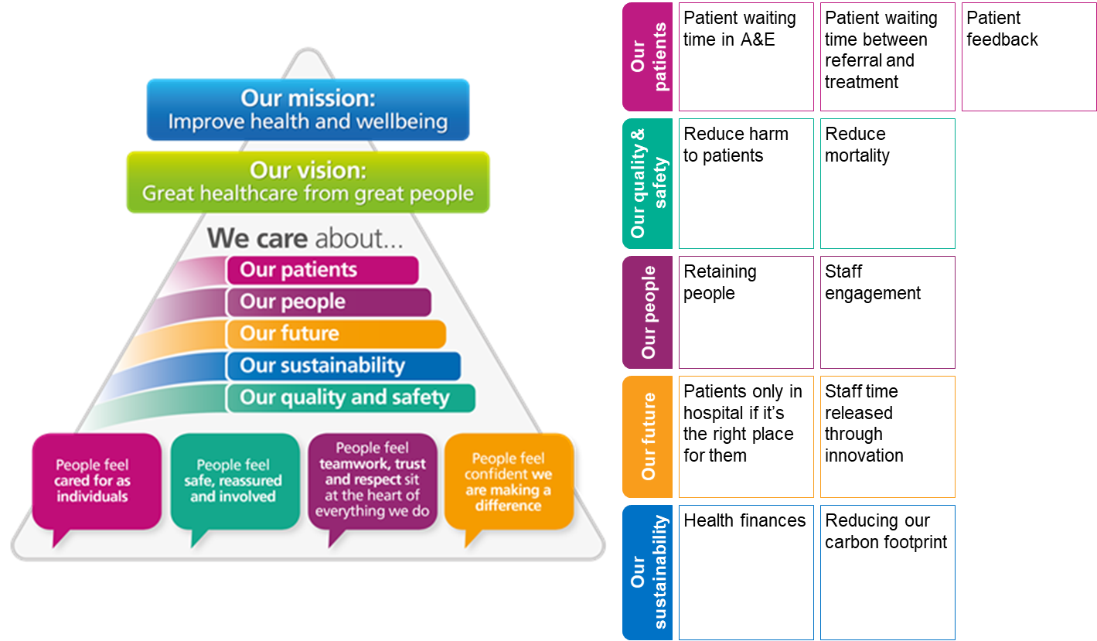
How ‘We Care’ will monitor and deliver our improvement
Our strategy deployment framework is used to assign a focused set of objectives to the Trust Executives, corporate teams and frontline creating clear focus.
Trust Strategic Initiatives
Trust priority improvement projects
We Care system
“Must do, can’t fail” long term strategic transformation programmes over 3-5 years.
We Care
Sustained access
System integration (PCBC for NHSE/I, stroke, ICP/ICS, cancer centre, vascular/IR, pathology, T3, KCR)
Proactive, Empowered and Engaged Culture
Projects to address our priority issues working with our key partners.
Delivered through 5 workstreams:
Maternity
Infection prevention and control (IPC)
Adult Safeguarding
Governance
Urgent and Emergency Care (UEC)
“Focus the Organisational Energy to align clinical and operational daily bottom up improvement efforts”
Performance managed through Ward to Board integrated scorecard and performance management system
Improvements driven through daily continuous improvement
Examples of bottom up improvement include reducing falls and improving theatre capacity
Reporting to the Improvement Steering Group, the Trust Board and oversight committees

Slide 31
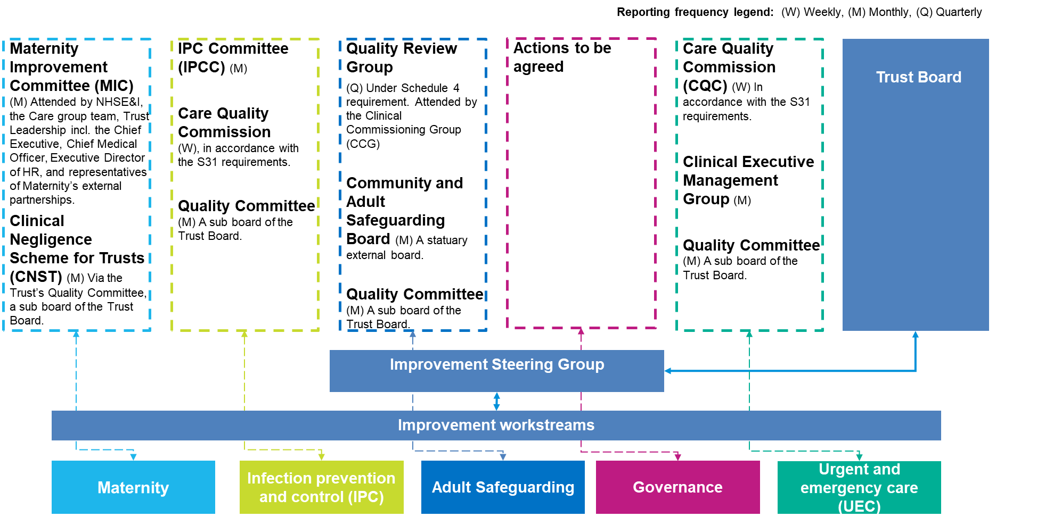
Governance of Trusts Priority Improvement Projects
Each improvement workstream will have an Executive Lead, responsible for overseeing the delivery of the workstream improvement plan actions
Completed actions will be supported by evidence, verified by Trust representatives independent of the improvement workstream, who have the relevant subject matter expertise
The impact of completed actions will be linked to metrics or qualitative examples of changes in cultural behaviour or ways of working and wherever possible capture the impact on patient experience.
The programme management office (PMO) will support the improvement workstreams with progress tracking and monthly reporting
Each workstream will produce a monthly report to internal and external oversight committees
Improvement Steering Group, chaired by the Chief Executive, will oversee implementation of the Trust’s Improvement Plan, approving monthly reporting to the Trust Board and external oversight committees. This governance system is summarised in the graphic below.

