Slide 1


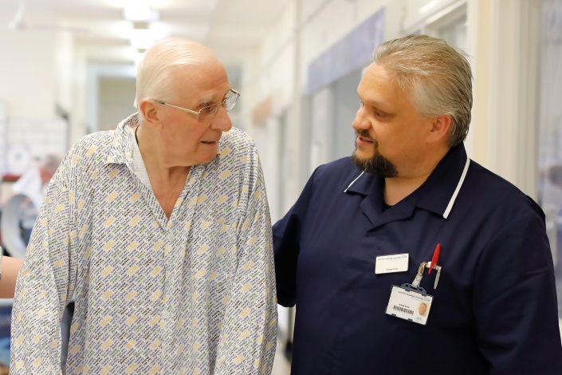
Our Quality Strategy
2019 – 2022
Delivering great healthcare from great people

Slide 2
Foreword
Welcome to East Kent Hospitals Quality Strategy, which sets out our vision for the quality of care we want to provide, our priorities for the next three years, how we will deliver them and the difference they will make to patients and their families, carers and staff.
We provide care from the start of life, to the end of life. Every day in east Kent people need great healthcare from people who are great at what they do and who work in an environment where they can give their best, we want this for every patient, every day.
We have extremely dedicated and caring staff and some excellent services, but we know there is much more to do to deliver the quality of care that we want for our communities. This strategy, which we have developed based on feedback from our staff, patients, partners and the public, sets out the vision and values for us to achieve that goal.
To deliver the best outcomes and experience for people who use our services, we need to have an excellent, highly skilled and motivated workforce, with the right equipment and facilities to provide excellent care.
We want the people who use our services to be involved in how we design and deliver them, and be involved in decisions about the care they receive.
We also work in partnership with other providers of health and social care, and the people who commission that care. We have a vital role to play in not just improving the health and wellbeing of our communities but also by being a good employer.
Everyone has a part to play in the delivery of this strategy, and must feel empowered, skilled and enabled to make positive changes to the way we work and the care we provide.
We measure quality using the five Care Quality Commission domains. We want the care we provide to every person, every day, to be as good as it can be. We believe we will achieve this by focussing on the five domains: safe, effective, caring, responsible and well led, so that by our next inspection we are delivering care that is judged as at least Good by the CQC. We will then build on this until every service is rated as Outstanding.
This ambition is one of our six organisational objectives. Our objectives are all interlinked and support each other, to deliver our vision - great healthcare from great people - for every patient, every day.
Susan Acott
Chief Executive

Slide 3
Definition and context of our strategy
How we define quality? | Why do we need a strategy? | What is the strategic framework?
Safe – avoiding harm to patients from care that is intended to help them; Effective – providing services based on research evidence knowledge of local context professional expertise and patients own knowledge of self; Person-centred – providing care that is respectful, compassionate, and responsive to individual needs and values; in partnership with patients and carers to support their choices; Timely – reducing waits and sometimes harmful delays; Efficient – avoiding waste and un-necessary cost; Equitable – providing care that does not vary in quality because of a person’s characteristics or location. | Our strategy supports us to continually improve the services we provide for our patients and their families; and demonstrate how we will do this so we can be held to account; Our strategy aims to make explicit the quality improvements we will make over the next three years, how we are going to achieve those goals, and what needs to be in place to enable the goals to be achieved; The strategy sets out how we will monitor the progress we are making and measure the effectiveness of the improvements we make; The strategy has been informed through listening to patients, staff, partners and stakeholders and feedback gathered including from patient and staff surveys. | Our strategy reflects the priorities of the NHS long-term plan, the importance of integration of services and partnership working; The strategy and our priorities reflect the needs of our communities and the priorities of the integrated care system and local partnership; The strategy is based on national guidance and best practice, and uses the CQC domains to measure quality; Our strategy recognises the importance of having good governance structures and processes which enable us to provide assurances from ward, department and team to the Board; It reflects our values and recognises the importance of culture.

Slide 4
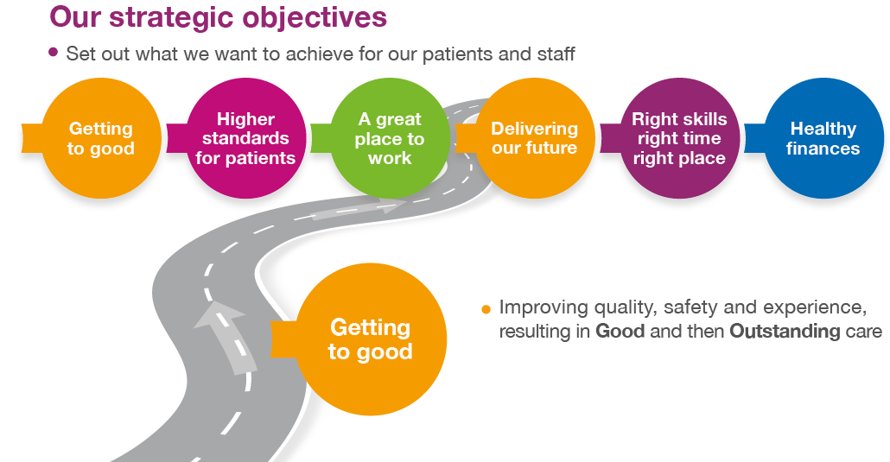
Quality at the heart of our objectives
Our vision to be a leading provider of acute healthcare services 'Great Healthcare from Great People‘ will be delivered through our six strategic priorities 2019-22 (Appendix 1). They will drive performance, particularly in the key access standards; make the Trust a great place to work; deliver a more sustainable future for our services; develop our staff and teams and finally, improve our finances. Each strategic objective has a number of measures of success. However , these are not the only Trust indicators of quality.
This Quality Strategy supports all of our objectives but particularly focuses on the first and foremost, Getting to Good, which drives improvements to quality and safety of care and patient experience, measured through a Good and then Outstanding CQC rating.
Our objectives are delivered through interlinking strategies, many of which have a direct influence on our patients` experiences of the care they receive. For example there is a well established link between staff experience and patient experience; patients have told us that access and waiting times significantly impact on their overall experience and evidence links access and waiting times to patient safety and clinical effectiveness.
Quality Strategy Clinical Strategy Workforce Strategy People Strategy IT Strategy
Operational Plan Research and Innovation Communications and Engagement

Slide 5
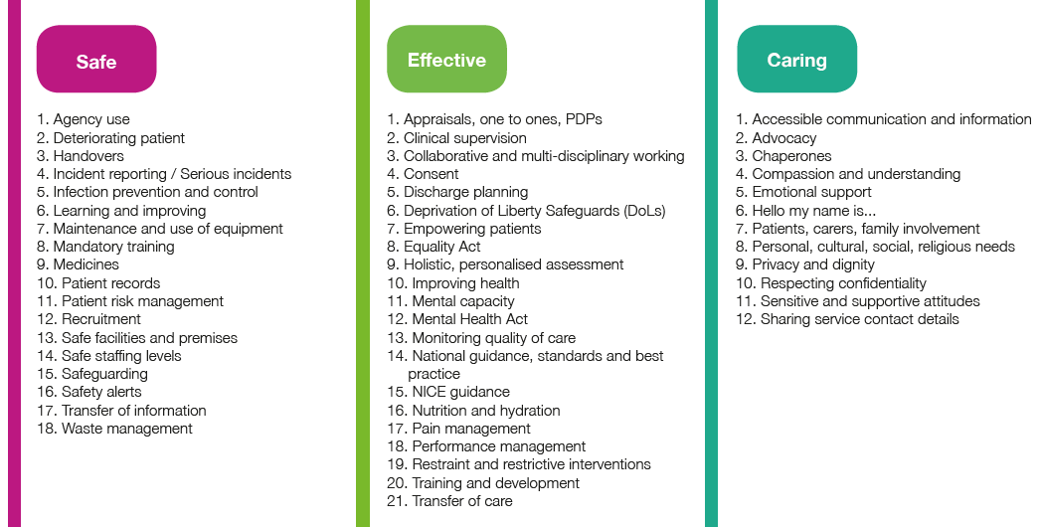
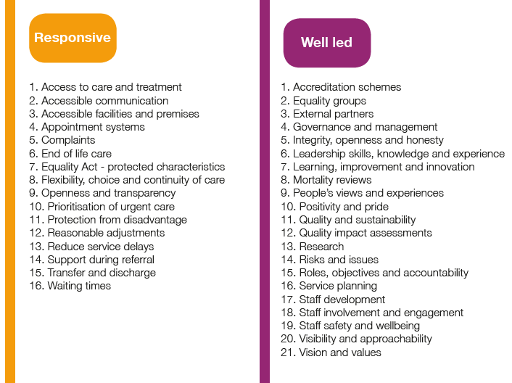
How we measure and deliver quality
We measure quality using the five Care Quality Commission domains: safe, effective, caring, responsible and well led. Our ambition is to be delivering, by our next inspection, care that is judged as at least Good by the CQC. We will then build on this until every service is rated as Outstanding.

Slide 6
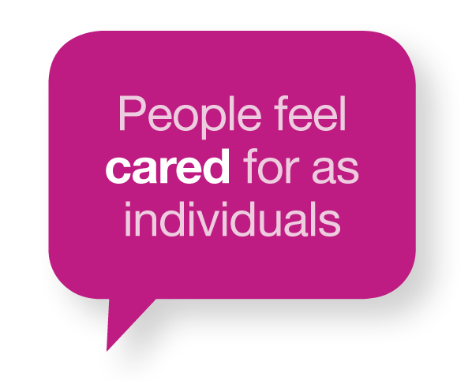
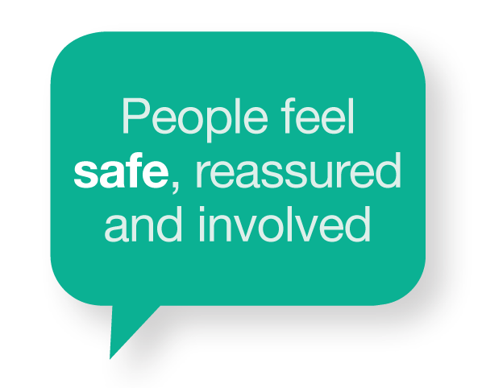


How we measure and deliver quality
How we will deliver these objectives will be driven by our values, these are very important to us and we want everyone who experiences our Trust, as a patient, visitor or member of staff, to feel cared for, safe, respected and confident we are making a difference.
These are the values we as a Trust Board will demonstrate and expect from our staff in our every day working lives. Quality and the values we expect and demonstrate at all levels of the organisation impact directly on our patients. It is important our responsibilities and expectations are explicit.
It is the responsibility of the Board to create a culture within EKHUFT that enables multidisciplinary working at its best and have systems in place for measuring and monitoring quality and escalating issues, including to the Board.
Ultimately our quality strategy will be monitored by the Trust Board through the Quality Committee which is chaired by a Non-executive Director. The Board will seek assurance that our quality priorities are being met and that we can evidence our success measures.
Four quality priorities are described in this strategy:
Improving quality and safety to improve patient experience and outcomes
Delivering CQC Improvement Plan, integrating it as our core business
Transforming end of life care
Learning from deaths
Each of the above are supported by key actions and measures of success.

Slide 7
Quality priorities
Improve quality and safety to improve patient experience and outcomes, by:
Improved medicines management safety; identification, treatment and support of patients at high risk of deterioration; pressure ulcers and MUST scores
Delivering the Falls Stop programme and a reduction in falls
Embedding culture of safety and quality excellence, improvement in patient care and experience
Patient experience and clinical outcomes in top quartile
Improving clinical outcomes for patients by ensuring, where clinical audits identify scope for improvement , action is taken
How we will know:
Sustained top quartile FFT performance
Patient surveys and the annual results of the national patient cancer survey will show year on year improvements that demonstrate our commitment to keeping our patients safe
Harm as identified in our strategic objectives is reduced as set out in “Getting to Good” 2019/20 (appendix 2); Further improvements will be agreed for 2020/21 and 2021/22 respectively
Human factors training delivered in all high risk areas
Patient safety culture survey tool agreed, demonstrating year on year improvement
Patient VTE percentages agreed and improved on year on year
Improvements in staff survey results year on year
Action taken as a result of clinical audit are evidenced through the NICE CAEC report to the Quality Committee
Key national audits show improving compliance within set timeframes
Sustained reduction in complaints

Slide 8
Quality priorities
2. Deliver CQC Improvement Plan, integrating it as our core business, by:
Achieving a CQC rating of good by our inspection in 2020/21
Being recognised for delivering outstanding care by 2022/23
How we will know:
Constitutional standards met
Avoidable harm reduced
Appraisal compliance met and year on year improvements demonstrated
Mandatory training compliance met year on year and sustained
Improvements evidenced in the national emergency department; Cancer and Inpatient surveys
Improvements evidenced in the annual staff survey and staff recommending the Trust to friends and family, as well as a good employer
Reduction in serious incidents and never events as a result of organisational learning

Slide 9
Quality priorities
3. Transform end of life care, by:
The Compassion Project is embedded across the organisation
End of life care that is compassionate, caring and provided in conjunction with the wishes of patients and their carers, meeting the national audit standards
How we will know:
Patient and carer experience feedback – FFT above Trust average
Annual national patient survey results will reflect year on year improvement in the experience of patients, families and carers
Compassion project delivered
Increased uptake of compassion training – 10% improvement year on year
The number of patients who die in their preferred place is improved and will improve year on year
Improvement in Do Not Attempt Resuscitation (DNAR) recording, reflecting discussion has taken place with patients and families including those without mental capacity
National audit standards delivered by 2021/22

Slide 10
Quality priorities
4. Reduce mortality and increasing learning from deaths, by:
The maternity transformation programme in line with the Saving Babies’ Lives Campaign
The continuing national ambition set out in Better Births
Further development of a programme of structured judgement review of deaths occurring in our hospitals to understand where there have been problems with the quality of care so that common themes and trends can focus the organisations’ quality improvement work
Improved identification, escalation and response to the deteriorating patient
How we will know:
Year on year improvements in the Trust mortality indices
Increased percentage of deaths within hospital having a structured judgement review
Reduction in the number of cases where a problem in care is identified
Maternity transformation programme delivered
The continuing ambition set out in Better Births is delivered
Year on year continuous improvement in clinical outcomes, e.g in stroke and diabetes audits nationally
Clinical incident data shows a reduction in incidents relating to the recognition and response to deteriorating patients causing moderate or above harm
Learning from deaths programme delivered both at corporate and Care Group level
End of life care national standards met
Medical Examiner appointed by April 2020

Slide 11
Implementing our strategy
Learning and cultural change | Engagement and culture | Governance and accountability
Continuous learning and quality improvement Embedding and sustaining learning Embedding a patient safety culture Leadership development strategy Service and improvement training plan - (KENT) Research and innovation Quality improvement and innovation hubs | Team working and integration Permission to make change Empowering our staff Staff engagement Patient experience and engagement Engagement with external partners and stakeholders Every member of staff understanding their contribution, and included in professional and personal objectives Regular feedback and recognition of individual’s contributions Monitoring of patient and staff feedback to establish the difference we are making | Owned by Care Group Clinical Director, Operations Director and Director of Nursing responsible with their teams for delivery Clinically led with quality standards developed and agreed with Clinical Care Groups Clinical audit and clinical effectiveness Integrated governance and support systems across the organisation Clinical Care Groups monitoring and reporting delivery through the Trust’s governance framework Annual review and realignment to the Trust’s strategic objectives Executive responsibility: Chief Nurse / Director of Quality and Medical Director Oversight through the Trust`s Quality and Risk Group and Patient Safety Committee, reporting at Board level through the Quality Committee.

Slide 12
Next Steps
Quality strategy is embedded in the Care Group governance framework
The quality strategy will be subject to annual review and inform the Care Group planning cycle
The Trust will implement a Quality Improvement methodology
Quality improvement to be whole system thinking

Slide 13






Appendix 1
Our strategic objectives
Improve quality, safety and experience, resulting in Good
and then Outstanding care
.
.
Improve the quality and experience of the care we offer, so patients are treated in a timely way and access the best care at all times.
Making the Trust a Great Place to Work for our current and future staff
Transforming the way we provide services across east Kent, enabling the whole system to offer excellent integrated services
Developing teams with the right skills to provide care at the right time, in the right place and achieve the best outcomes for patients
Having Healthy Finances by providing better, more effective patient care that makes resources go further.

Slide 14

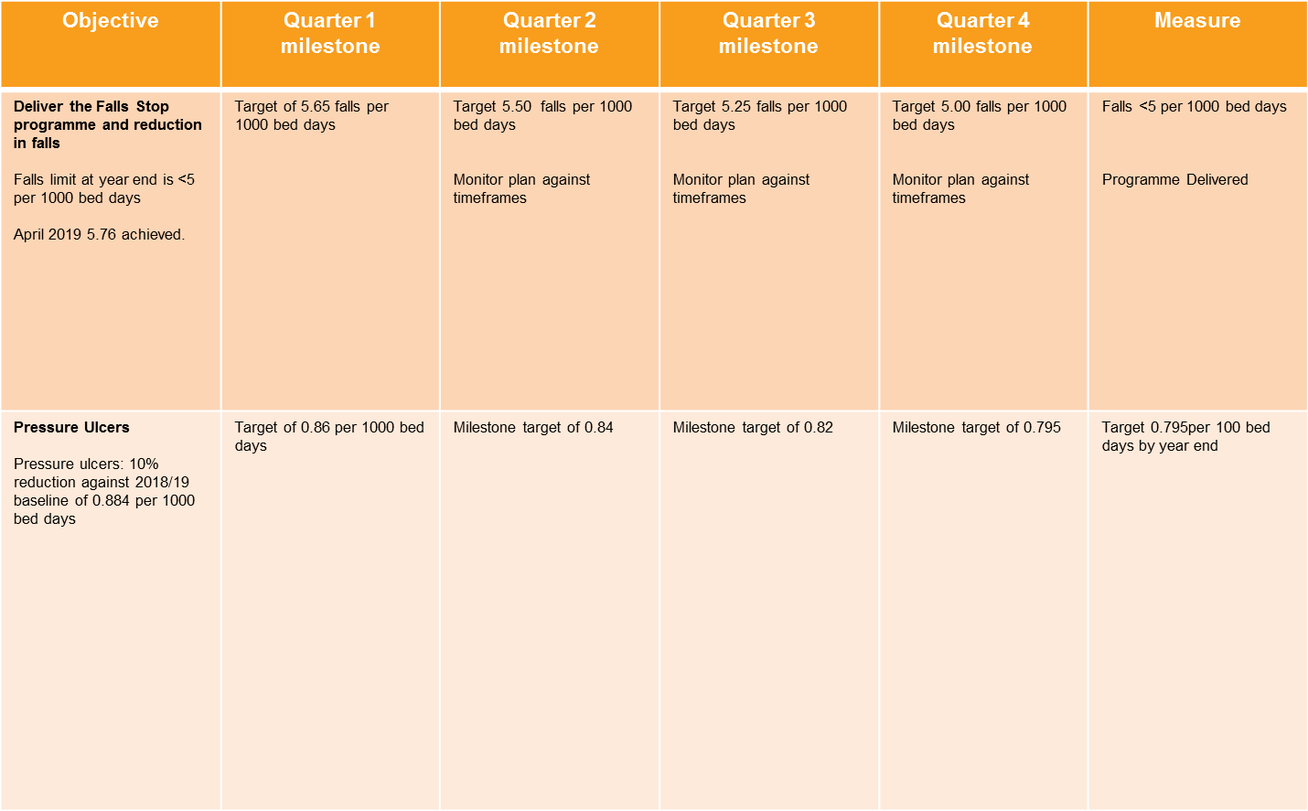
Appendix 2
Getting to good 2019-20

Slide 15

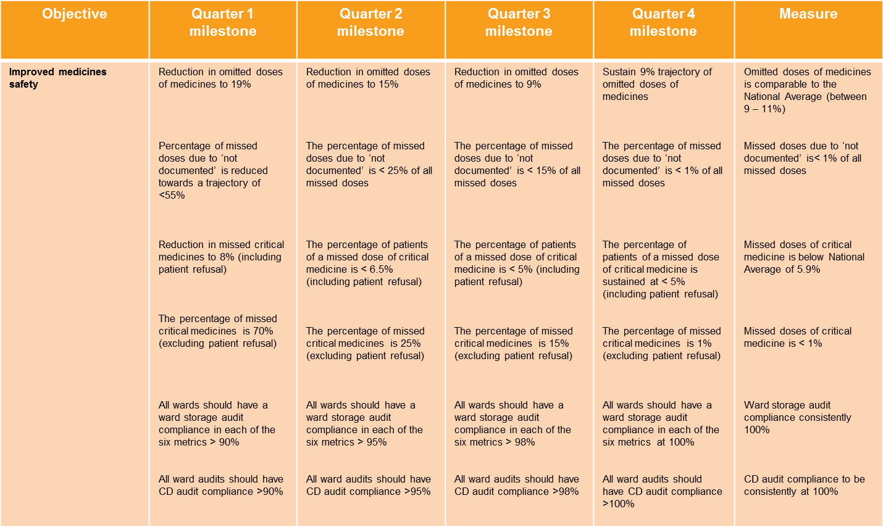
Getting to good 2019-20

Slide 16
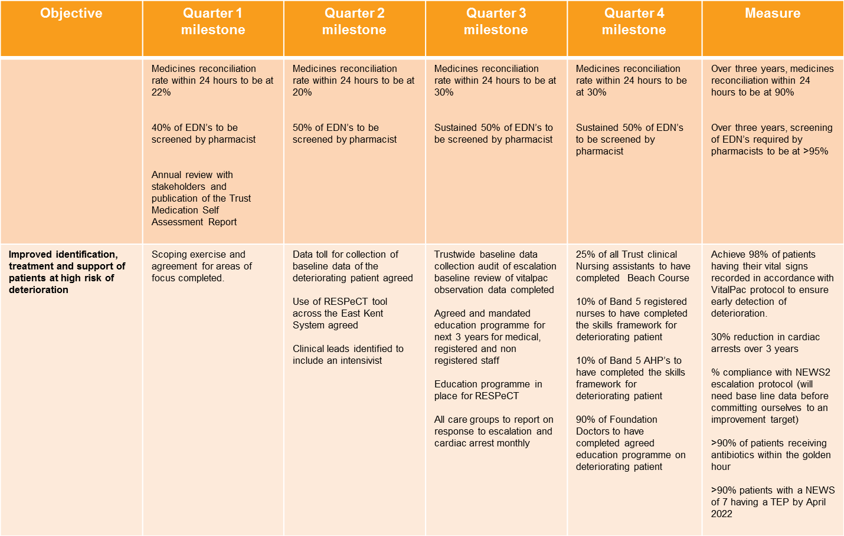
Getting to good 2019-20

Slide 17
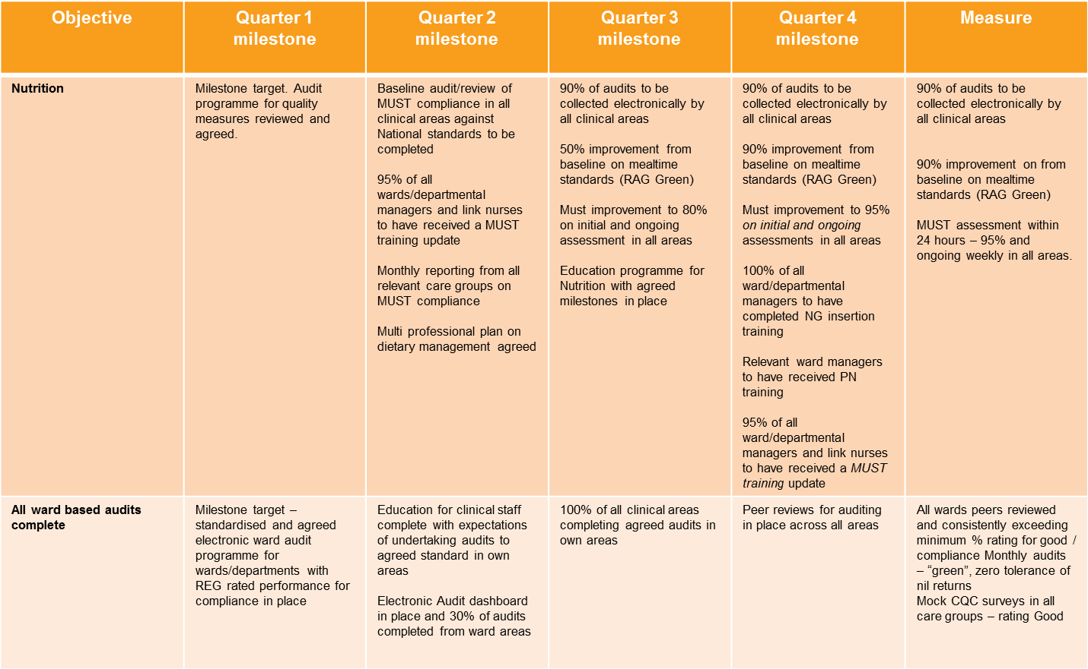
Getting to good 2019-20

