Slide 1
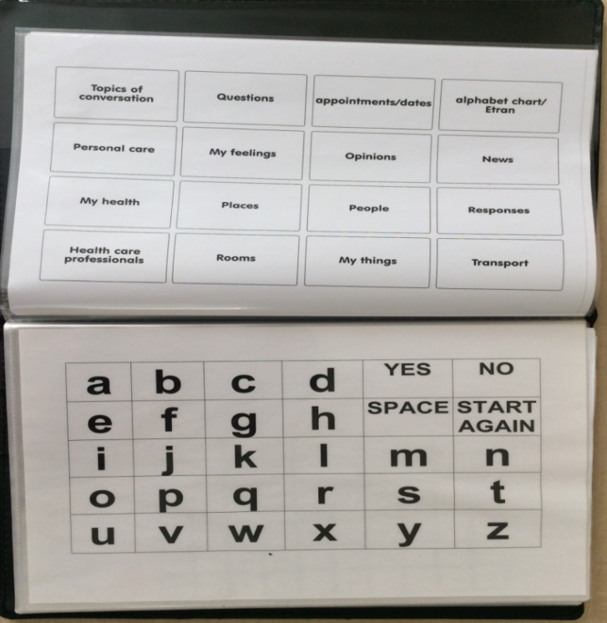
Low Tech AAC, Where Do I Start? Kent and Medway Communication & Assistive Technology Service – Adult Team

Slide 2
You will learn…
How to start assessing your client and some of the tools you can use.
How to start preparing low tech AAC for your client.
You will be signposted to relevant websites for more detailed information, videos, resources etc. The ACE Centre AAC ibooks (free) make excellent further reading.
http://acecentre.org.uk/getting-started-with-aac-ibooks-series

Slide 3
Why is Low Tech AAC important?
For some clients, Low tech AAC is the most suitable system.
Portable
Available as another option – e.g. when the client is in the bathroom, in bed etc.
Reliability! Available as a back up e.g. if problems with high tech AAC.
Do you always trust your Sat Nav? Best to have a map as well ! Or just a map!

Slide 4
Support
Find out early on, who is going to be the main support for the client’s AAC now and ongoing? E.g. updating vocabulary.
Define roles.

Slide 5
Barriers to overcome
Negative attitudes/beliefs about low tech AAC e.g. that high tech AAC is best.
Lack of support for the person using the AAC. Little or no opportunities to develop their skills. The AAC is tucked away.
Lack of motivation to use their communication system.

Slide 6
AAC
No such thing as the best type of AAC, it is the AAC that is best matched to the person. Matched re their:
Cognitive
Linguistic
Sensory
Physical
abilities

Slide 7
Starting your Assessment: Get to know your client!
Our AAC assessment referral form has information boxes (click on the which you can use to guide you to the information you need to gather e.g. about your client’s vision and physical abilities.
http://www.ekhuft.nhs.uk/patients-and-visitors/services/radiological-sciences/medical-physics/adult-cat-service/

Slide 8
Get to know your client!
You can learn a lot about your client through observation and asking questions to the client and their family/carers.
What is their functional vision like? Can they read? See the TV? See faces clearly? Physical abilities - how do they manage holding a cup when drinking, using a pen, keyboard etc. Do they fatigue?

Slide 9
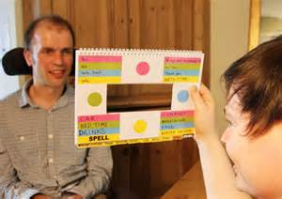
Posture & positioning
Good posture and positioning is important for the client’s comfort and to help them access AAC. Any issues should tried to be resolved as early as possible.
Liaise with OT, physiotherapist, wheelchair service etc., as necessary.

Slide 10
AAC Screening tools
AAC screening tools can be used along with speech and language therapist (SLT) assessments. http://www.mayer-johnson.com/tasp
http://www.logan-technologies.co.uk/frenchay
-screening-tool-for-aac
https://www.youtube.com/watch?v=2RA9wVvVmkA
You need to be building a profile of your client’s physical abilities, sensory skills, literacy, language skills and cognition.

Slide 11
Communication Matters
Communication Matters have some excellent information which include:
http://www.communicationmatters.org.uk/page/getting-started

Slide 12
Vocabulary Selection
Appropriate vocabulary is essential in order to participate as successfully as possible.
Vocabulary must be personal to the individual.
Language is not always positive – need a range of vocabulary.
Circle of communication partners (Blackstone 1999). http://www.communicationmatters.org.uk/page/vocabulary
Refer to KM CAT Guidelines for gathering vocabulary for AAC.

Slide 13
Vocabulary selection
Gather personalised (fringe) vocabulary e.g., I go (core vocabulary) cricket
Useful to include vocabulary to help them get started e.g. Please be patient
And to correct themselves, sorry I made a mistake, or to be creative, I will give you a clue.
Include core words (depends on client’s abilities) to give access to frequently used words.
https://aaclanguagelab.com/files/100highfrequencycorewords2.pdf

Slide 14
I need…is not enough!
LANGUAGE FUNCTIONS
Social exchange
Attention direction
Requesting information/objects/assistance/actions
Asking questions
Transferring information
Responding
Self expression/assertion
Negation
Negotiation
Communication repair following breakdown

Slide 15
Access
Direct Access: How is the client going to access the AAC? Directly i.e. can they use a finger to point/other body part? or use eye pointing.?
Indirect Access: via partner assisted scanning ?
http://www.mndassociation.org/wp-content/uploads/2015/02/54e-trans-frame-info.pdf
https://www.youtube.com/watch?v=LLkpRbUQzVohttps://www.youtube.com/watch?v=dUMnn-4FlIA
https://www.youtube.com/watch?v=pLb6-Oi3uR0https://www.youtube.com/watch?v=RLM5G-DYTDk
The AAC will need to be positioned so the client can see it clearly and be able to access it.

Slide 16
Access The size of the items and the spaces between each item will depend on the client’s visual and targeting skills. Clients needs may change e.g. physical decline

Slide 17
Establish the access method: direct or indirect access. Or some clients use both.
Determine whether text based or symbol based.
Symbols (establish the type) with/without text. Or use of photos, pictures.
Amount of vocabulary to start: number of items per page, number of pages, layout of pages.
Organising vocabulary
Other customisation : colour coding etc.

Slide 18
Organising vocabulary
e.g.
Topic board/pages
PODD http://lburkhart.com/podd.htm
Categories
Core vocabulary

Slide 19
Literate clients
E.g. Alphabet chart; establish whether Qwerty or ABC/other layout.
Alphabet chart with phrases
A more comprehensive communication book with messages put into categories/topics.
Partially literate clients may still benefit from an alphabet chart, words and phrases.
Example of pre made low tech AAC (with key guard)
http://www.fab.uk.com/

Slide 20
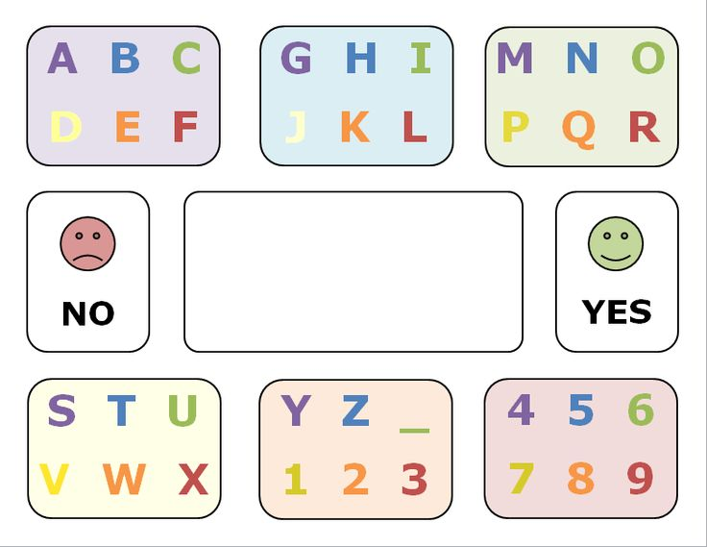
Literate clients
http://www.spectronics.com.au/blog/tools-and-resources/free-downloadable-alphabet-boards-for-people-using-aac/
http://acecentre.org.uk
http://communicationmatters.org.uk

Slide 21
Symbol users
Concrete i.e. more easily guessable symbols
Mix of concrete and abstract symbols
Can the client manage with some abstract symbols ? Unfortunately, many of our frequently used (core) words use abstract symbols.
http://www.communicationmatters.org.uk/page/symbols

Slide 22
Creating AAC
There is a variety of software available for creating low tech AAC.
http://www.communicationmatters.org.uk/page/symbol-layouts

Slide 23
Supporting your client
Start and develop. The client’s low tech AAC can begin as a couple of pages. When adding vocabulary, avoid moving items around too much. Therefore, plan for development of the AAC.
Use and model the symbols during conversation, support the client’s own communication attempts.
Give the client opportunities to use their AAC in different contexts with a range of people.

Slide 24
Further AAC learning e.g AAC Scotland online AAC modules
http://www.aacscotland.org.uk/Online-Learning-Modules/Introduction-to-AAC/Module-1---Interactive-Version/
Different modules available

Slide 25
Good Luck!

Slide 26
Communication passports
Gathering important and useful information about the person.
How the person communicates across all situations and contexts and using all methods.
It can give information on eating, drinking, personal care and interests. http://www.communicationmatters.org.uk/page/communication-passports

