Slide 1


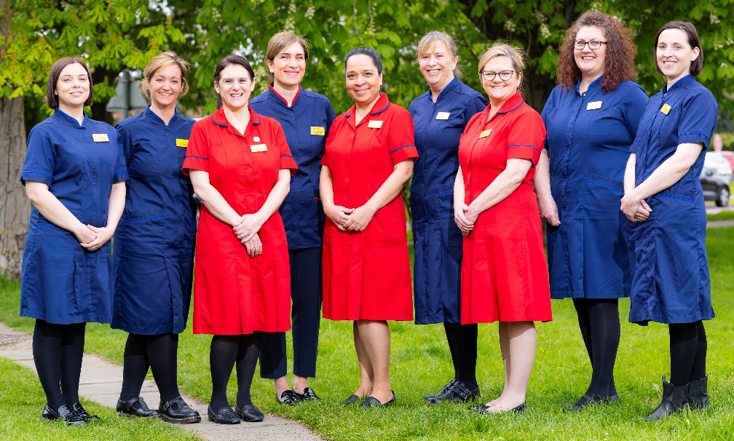
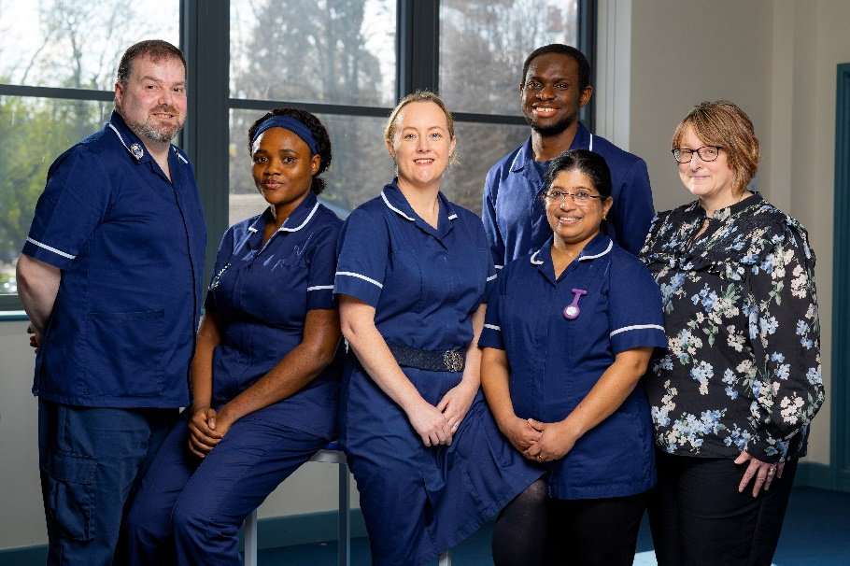

Ambitions for Nursing and Midwifery 2024-2029

Slide 2
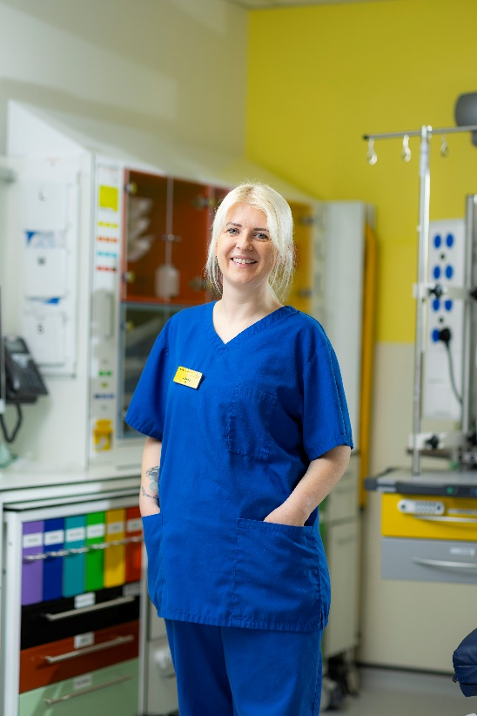
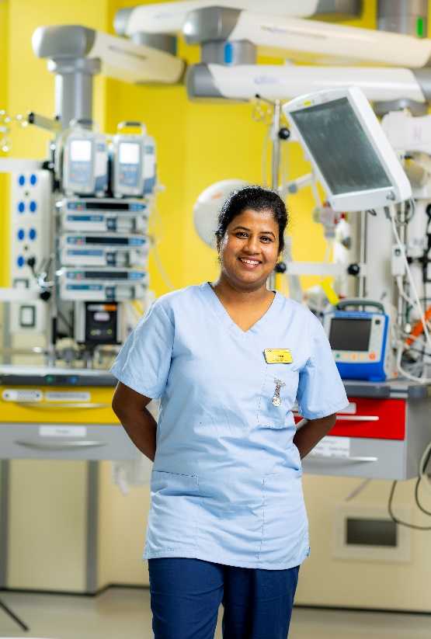
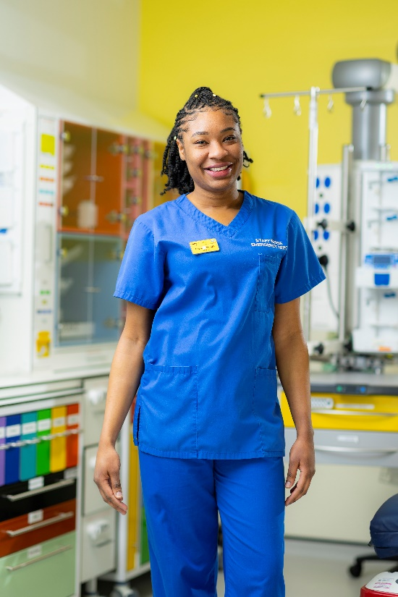
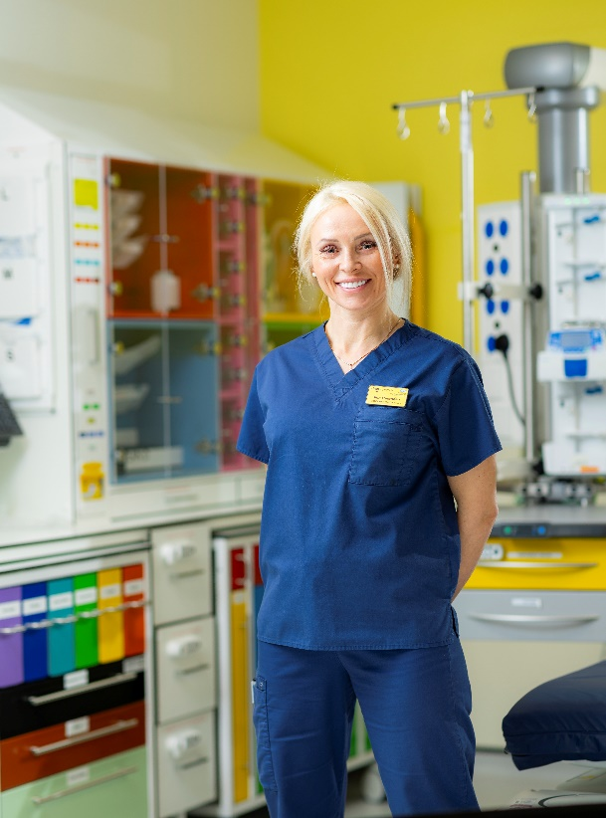
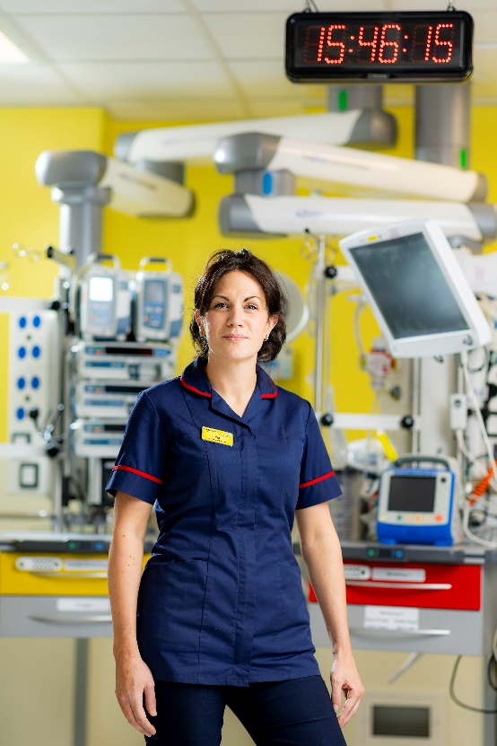
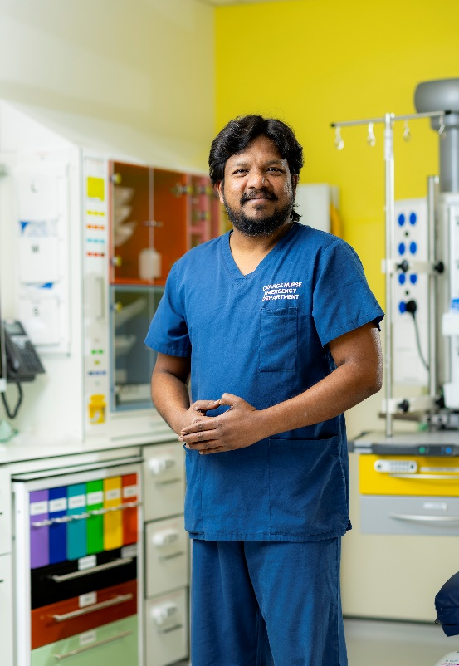
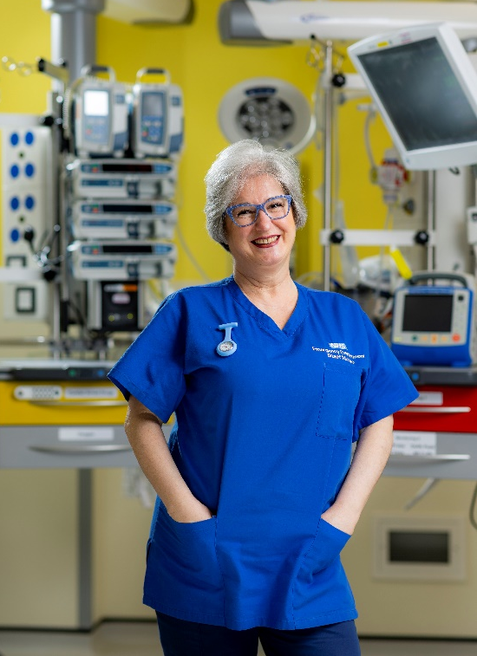
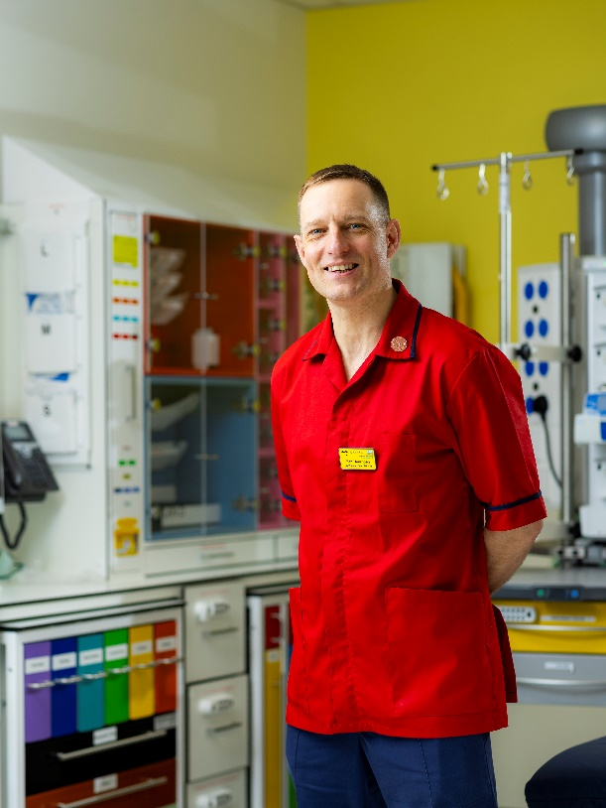

Slide 3
INTRODUCTION
I am delighted to introduce our seven strategic ambitions for nursing and midwifery for the next five years. They provide a framework to support us in achieving our Trust vision to deliver great healthcare from great people underpinned by our values:
People feel cared for, safe, respected and confident we are making a difference.
These seven strategic ambitions set out our unique contribution as nurses and midwives and build on our strengths and considerable achievements which are already underway.
Collaboration with clinical colleagues and alignment with other Trust strategies such as the emerging AHP Ambitions, clinical strategy and trust strategy and our existing digital strategy will be crucial to our success.
Setting out our ambitions in this way gives us direction and momentum in our journey to excellence and ensuring all our patients and service users receive the best possible care. I hope you will also find them useful as a basis for your career conversations and appraisals.
I would like to extend my personal thanks to everyone who has been involved in the development of these ambitions. I have every confidence that together we can achieve them.
Sarah Hayes
Chief Nursing and Midwifery Officer

Slide 4
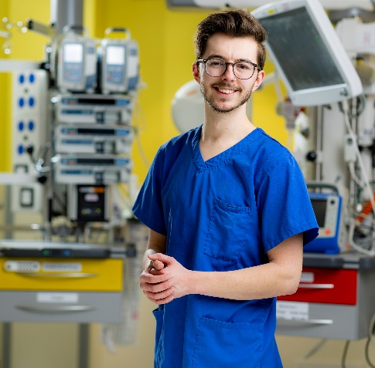
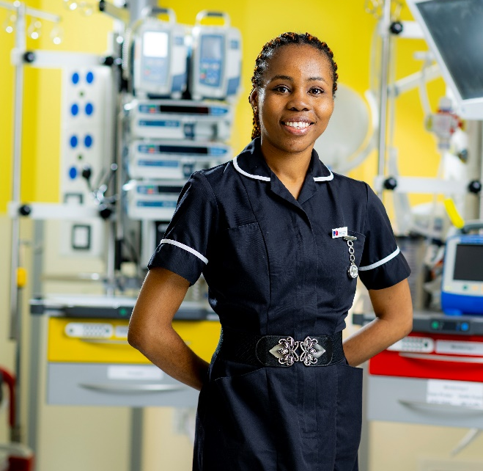
Our ambitions
By 2029 Nurses and Midwives at East Kent Hospitals University NHS Foundation Trust will:
consistently deliver high quality, timely care that is safe for patients and staff
have a strong professional voice and influence clinical and strategic decision-making at every level
continually develop nursing and midwifery practice, using data and research to inform and improve care
flourish, advance and succeed professionally for the benefit of patients
work safely in appropriately staffed teams in all settings and services
feel enabled to develop clinically and professionally with access to meaningful and rewarding career pathways
be involved in local, regional and national networks and activities to celebrate and share good practice

Slide 5
Ambition 1:
Nurses and midwives consistently deliver high quality, timely care that is safe for patients and staff
Actions
Outcomes
Measures
Recognise nursing and midwifery as safety critical professions and essential to patient flow
Invest in digital methods for capturing audit and performance data
Enable nurses and midwives to access quality improvement support and skills
Establish ward, department and unit accreditation programmes
Embed Professional Nurse and Midwifery Advocates and empower nurses and midwives to raise concerns safely without fear of retribution
Collect and learn from patient and family stories across all services and settings
Celebrate successes and share best practice
Ensure processes, policies and guidance are reviewed regularly.
Invest in the physical environment.
Patients and families experience outstanding, timely and harm free nursing and midwifery care
Reduction in waiting time breaches
Patients and families feel listened to and included in care decisions.
Care is person centred, holistic and culturally appropriate
Clinical governance is embedded in the day-to-day practice of nurses and midwives
Processes, policies and guidance is up to date, appropriate and relevant.
The governance team are visible in the clinical environment.
The environments that nurses and midwives work in are safe and fit for purpose.
Feedback from patients, children, families and carers
Results and themes from surveys including quarterly Pulse and annual Friends and Family Test
Maternity Incentive Scheme and quality ratings from regulators including CQC and NMC
Complaints and compliments
Numbers of PN/MA available and activity reports
Incident reports, audit data and ward heatmaps and scorecards
Ward, unit and department accreditation scores
Feedback from students on placements

Slide 6
Ambition 2:
Nurses and midwives have a strong professional voice and influence clinical and strategic decision-making at every level
Actions
Outcomes
Measures
Attention to inter-professional relationships and ways of working
Engagement in Culture and Leadership programme
Enable nurses and midwives to make a full contribution to service delivery and interprofessional teams.
Ensure nursing and midwifery representation on Staff Council.
Ensure opportunities for nurses and midwives to participate in decision-making at every level.
Empower nurses and midwives to present ideas and be heard
Effective and mutually respectful interprofessional relationships
Nurses and midwives report they feel valued and engaged
Increased nursing and midwifery commitment to EKHUFT strategic and operational plans
Raised profile of nursing and midwifery in EKHUFT, locally, regionally and nationally
A proud and confident nursing and midwifery workforce that takes charge of its future
Increase in the number of nurses and midwives participating and engaging in decision-making at all levels in the Trust and externally
Trust Pulse, NHS Staff survey results and EKHUFT people, leadership and culture metrics (increase engagement score from 5.95-6.80)
Feedback from decision-makers on how they have sought and used nurses and midwives feedback and opinions
The impact on nursing and midwifery is considered in every strategic and operational plan

Slide 7
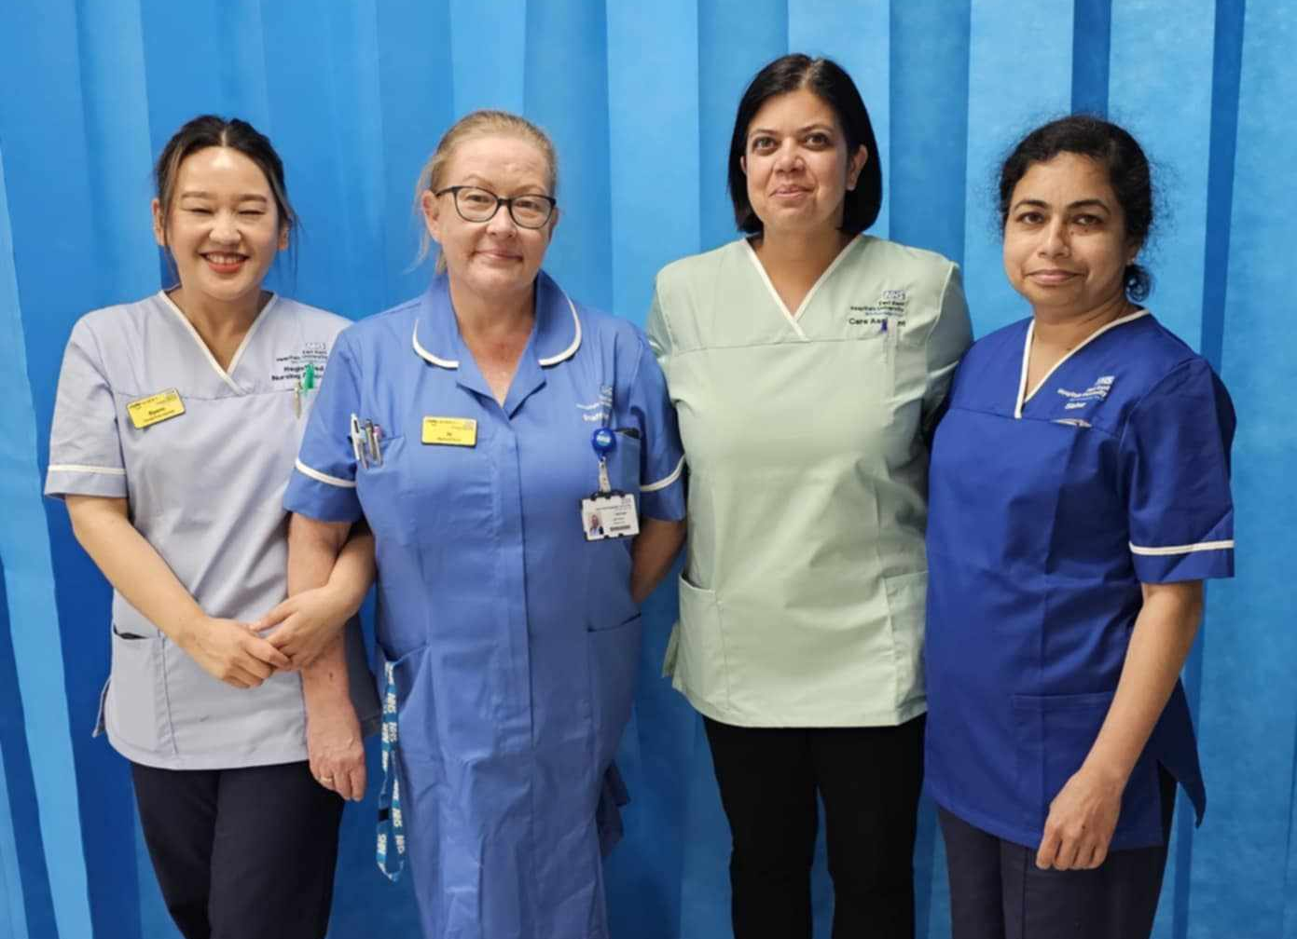
Ambition 3:
Nurses and midwives continually develop nursing and midwifery practice using data and research to inform and improve care
Actions
Outcomes
Measures
Build research capacity, capability and confidence in nurses and midwives
Recognise nurses and midwives as integral to the development of the digital infrastructure and provide equipment and training and support to use it
Encourage professional curiosity and maximise opportunities, including protected time, for nurses and midwives to be involved in service improvement and research.
Provide training to help nurses and midwives analyse and interpret data and use it in service improvement.
Establish digital and research leads in all settings and services
Work with universities and other partners internally and externally to develop clinical academic roles and pathways.
Increase in the safety and quality of nursing and midwifery care
Nurses and midwives are digitally literate and have ready access to the data, information and knowledge they need for care
Increased numbers of nurses and midwives using, participating in and leading research.
The practice of nurses and midwives is informed by research evidence
Patient experience and outcomes data
The numbers of nurses and midwives involved in the development of digital solutions and at all stages of the digital transformation
Numbers of nurses and midwives who are leading their own research projects and numbers who are involved in research
Numbers of nurses and midwives at with Masters and Doctoral degrees
Numbers of nurse and midwife consultants active in research
Student feedback from placements on the use of research in practice

Slide 8
Ambition 4:
Nursing and midwifery are seen as professions in which everyone can flourish, advance and succeed
Actions
Outcomes
Measures
Promote nursing and midwifery jobs and careers in our local communities and amongst our nursing and midwifery support staff
Support a wide range of pathways into nursing and midwifery including student nurse associate and degree apprenticeships.
Increase provision of work experience and placements to maximise recruitment and support learning on all pathways.
Support with study skills
Ensure diverse shortlisting and interview panels and transparent and fair recruitment processes.
Enable all nurses and midwives to use their previous experience to support their careers at EKHUFT
Establish career café’s and easy to use processes for accessing CPD funding.
Positive relationships with local schools and colleges
EKHUFT seen as an anchor organisation in our local communities
Fewer vacancies
Increase in numbers of appropriate applications for vacancies
Improved workplace experience of all staff
Diversity of nurses and midwives at senior levels reflects the diversity at junior levels and in the local population
Data on well-being at work.
Analysis of recruitment data by protected characteristics
Analysis of Pulse and NHS staff survey results by all protected characteristics
(increase engagement score from 5.95-6.80)
Workforce Race Equality Standard and Workforce Disability Equality Standard data
Data on diversity of participants supported on clinical and leadership development programmes

Slide 9
Ambition 5:
Nurses and midwives work safely in appropriately staffed teams in all settings and services
Actions
Outcomes
Measures
Safe care and improved health outcomes
Greater awareness and appreciation of the needs of people with mental health and neurodiverse conditions
Better patient experience and high quality care
Sufficient staff with the necessary knowledge, skills and attitudes to meet patients’ needs and Trust’s priorities.
Being first choice employer for student nurses and midwives
Nurses and midwives take their breaks and report better work-life balance
Patient/service user experience and outcomes data
6 monthly Safer Nursing Care Tool data/Birth rate plus data with feedback quickly
Reduction in sickness and absence due to stress and anxiety (to below 15%), vacancies (from 9.6% to 5%), maintain turnover rates (below 10%) and reduce premature leavers (from 14.9% to <10%)
Vacancy and turnover rates
Trust Pulse survey and NHS Staff survey
Increase in nurses and midwives recommending EKHUFT as a good place to work (from 34.5% to 90%)
Exit interviews
Use digital tools biannually to set and review appropriate skill mix, numbers and ratios informed by national standards, acuity and dependency, research evidence and best practice
Scope and enhance skill mix to meet the needs of people with mental health and/or neurodiverse conditions
Review skill mix on shift by shift basis and embed clear processes for escalating staffing concerns and ensuring actions are taken to maintain safety for staff and patients
Enable flexible working within the needs of the service and review it regularly on an individual and organisational basis
Invest in return to practice, retire and return programmes, succession planning and legacy mentoring

Slide 10
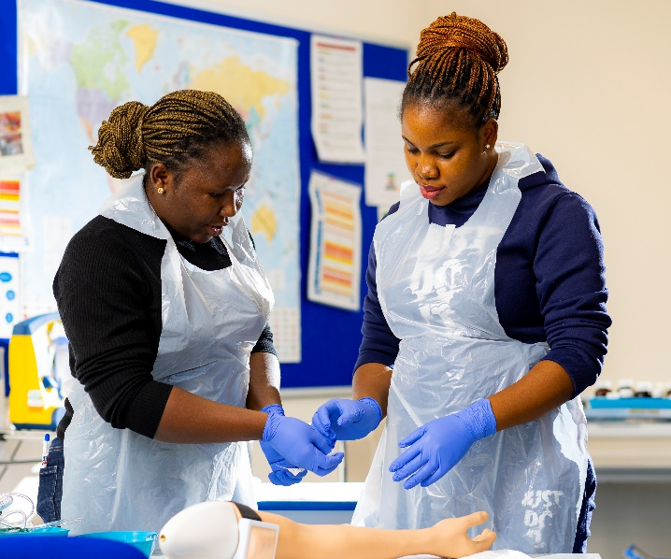
Ambition 6:
Nurses and midwives feel enabled to develop clinically and professionally with access to meaningful and rewarding career pathways
Actions
Outcomes
Measures
Develop a workforce model and talent management approach to ensure that all nurses and midwives have access to meaningful and rewarding career pathways from the point of registration
Increase the knowledge and skills of the workforce regarding mental health and neurodiversity
Invest in CNMO Fellowships
Provide access to Enhanced, Advanced and Consultant Practice training aligned to Trust and ICS clinical strategy and patient pathways.
Implement a trust-wide approach to job planning for Enhanced, Advanced and Consultant practitioners
Ensure appraisals are completed and are developmental in approach.
Act on feedback from exit interviews.
Care is delivered safely by the most appropriately skilled practitioner
Nurse and midwife-led pathways of care
Increased access to care
An improved framework of support and governance for Enhanced, Advanced and Consultant roles
Turnover rates and premature leavers rates
Appraisal rates
Advanced practice governance matrix
Numbers of nurses and midwives in Enhanced, Advanced and Consultant roles
Maintain turnover rates (below 10%) and reduce premature leavers (from 14.9% to <10%)
Numbers of nurse-led and midwife-led clinics and services
Trust Pulse survey, NHS Staff survey and EKHUFT people, leadership and culture metrics
Increase in appraisal rates from 74.8% to 95%
Exit interviews

Slide 11
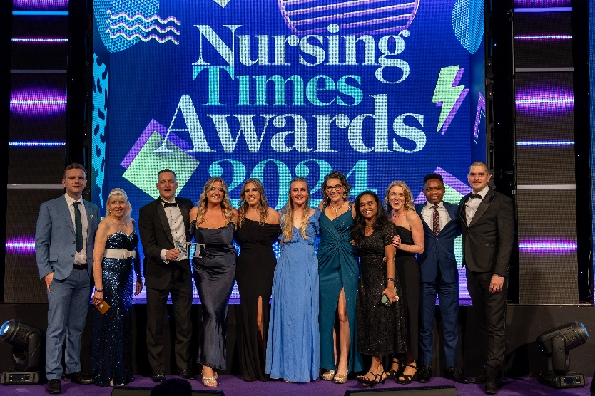
Ambition 7:
Nurses and midwives are involved in local, regional and national networks and activities to celebrate and share good practice
Actions
Outcomes
Measures
Develop nurses’ and midwives' knowledge, confidence and skills to celebrate and share good practice through mentorship, shadowing, rotations, coaching and development support
Provide opportunities, including time, for nurses and midwives to attend and speak at internal and external conferences, meetings and workshops.
Encourage nurses and midwives to nominate their colleagues and teams for awards internally and externally
Showcase the knowledge and expertise of nurses and midwives by opening up study days and courses to external applicants
Support nurses and midwives to publish their work
Positive impact on quality and standards of care and service delivery.
Greater understanding of the nursing, midwifery and specialist community public health roles and contribution by stakeholders
Increased confidence in nurses, midwives and specialist community public health nurses and development of a positive, public image of nursing and midwifery
Increased access to regional and national programmes and resources
Evidence of feedback from conferences, professional meetings and workshops on service delivery.
Increase in the number of nurses, midwives and specialist community public health nurses nominated/awarded
Positive local, national and international profile of nursing and midwifery at EKHUFT in the media

Slide 12
