Slide 1
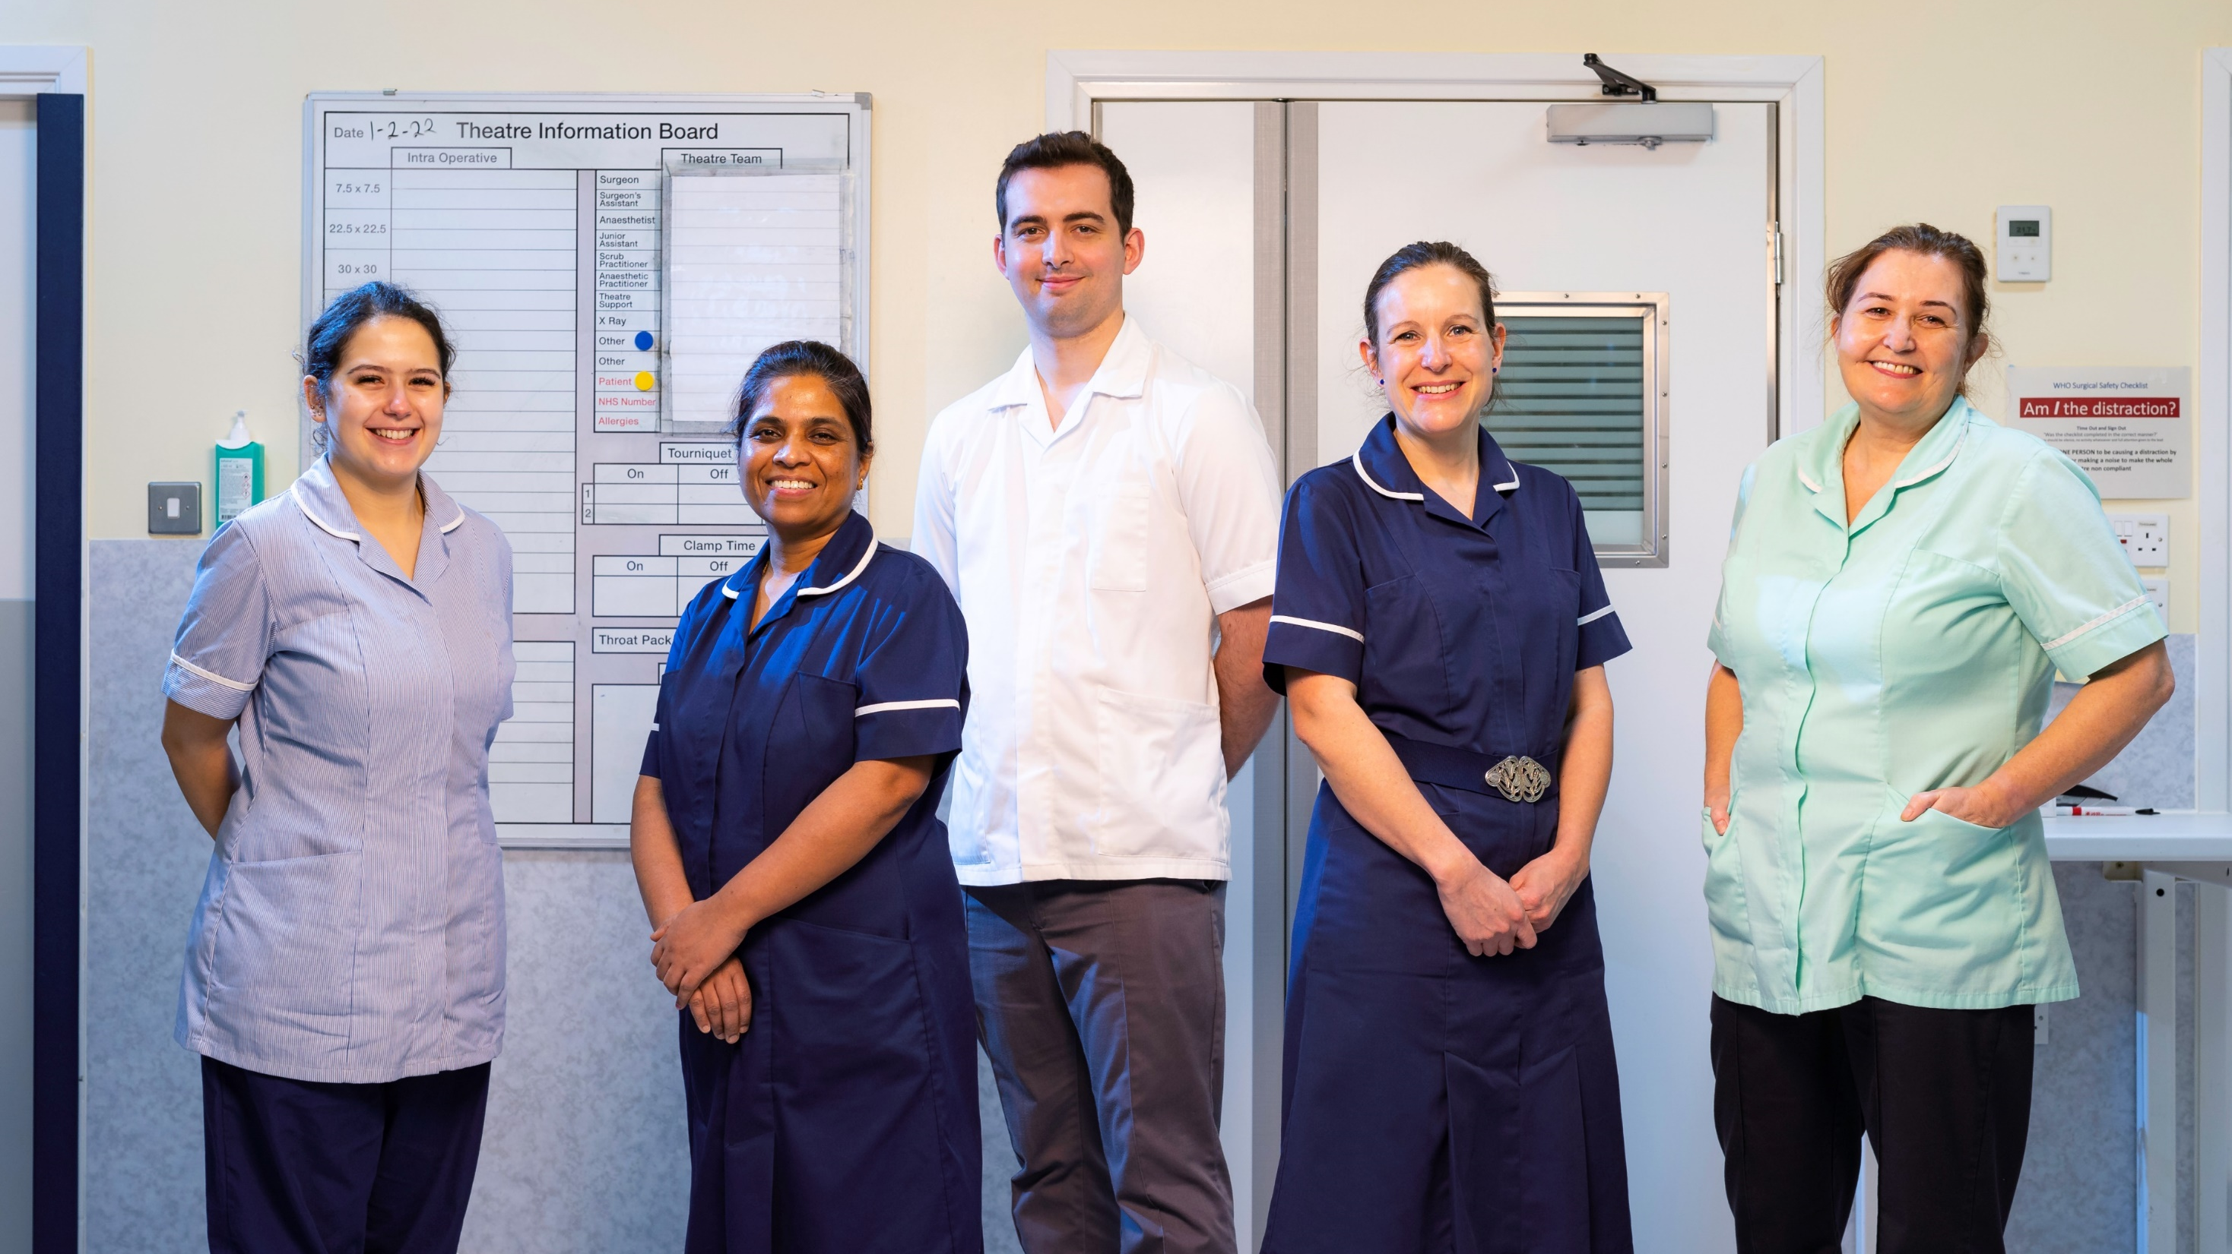


Appendix 1: Wellbeing Conversations & Leading for Wellbeing
Rachel Roberts – Senior Wellbeing Adviser
Appendix 1: Wellbeing Conversations &
Leading for Wellbeing
Rachel Roberts
Senior Wellbeing Adviser

Slide 2

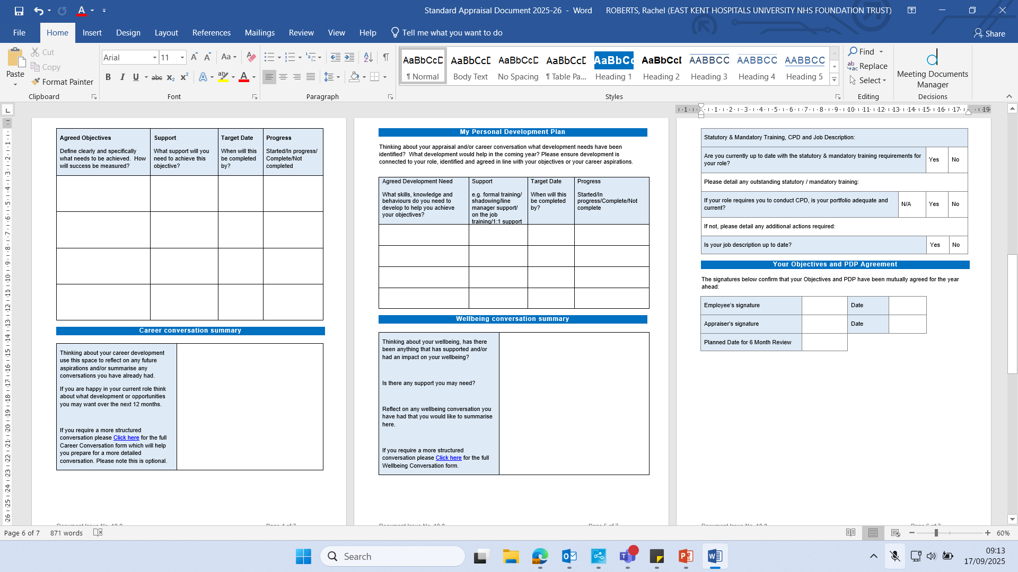
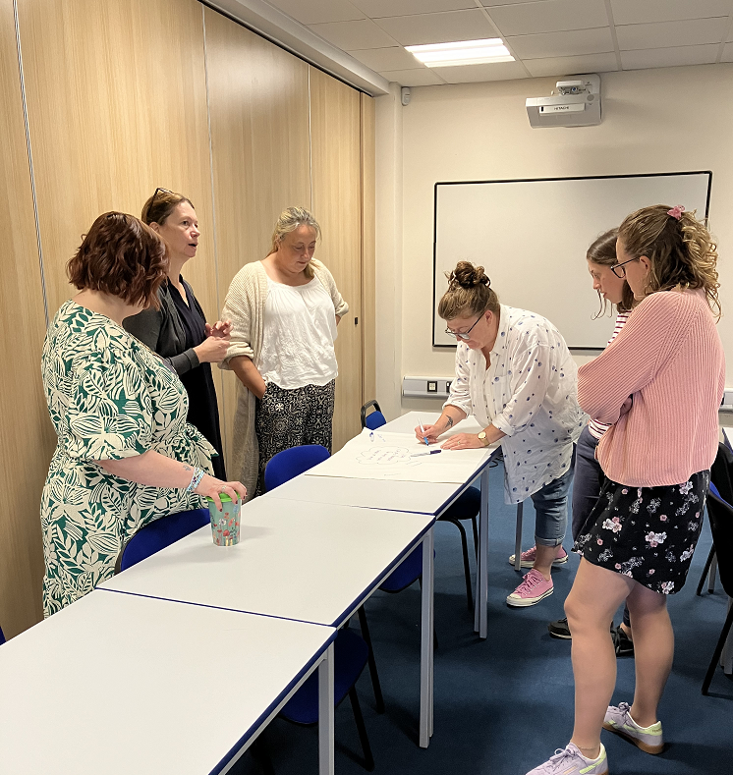
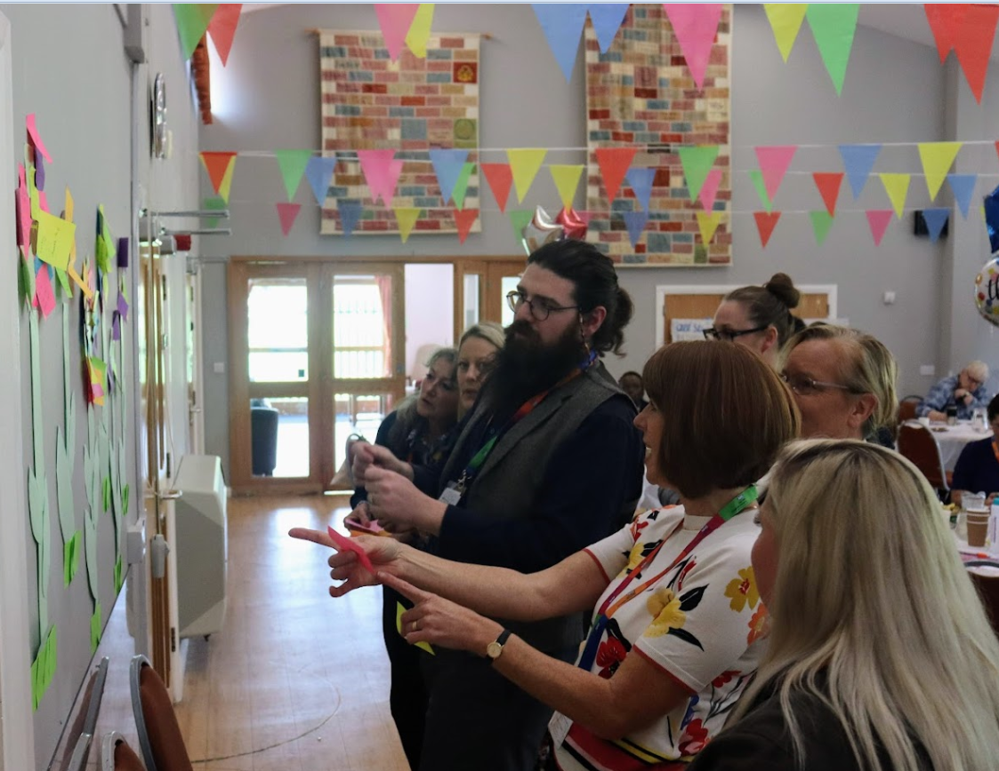
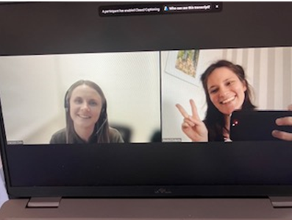
Wellbeing Conversations - Development & Rollout
Wellbeing Conversations – Development & Rollout
March 2022
Wellbeing Team Undertook Wellbeing Conversations National Training & Train the Trainer (TTT) Programme
Summer 2022
Wellbeing Team rolled out a 90min Virtual Wellbeing Conversations Training Program
Autumn 2022
Wellbeing (WB) Team developed the ‘Wellbeing Garden’ and other activities based on WB Conversations Training.
January 2023
Wellbeing Team rolled out Face to Face (F2F) Wellbeing Conversations training on a bespoke basis following team requests.
2025
Appraisal paperwork refined so it feels more authentic, less tick-box.

Slide 3
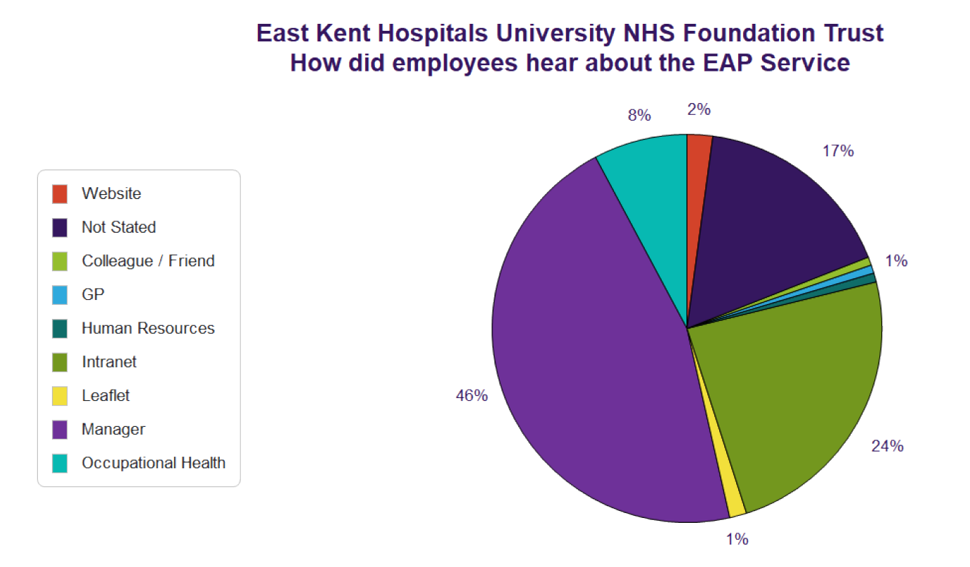
Wellbeing Conversations – Results & Impact
Wellbeing Conversations – Results & Impact
492 Colleagues Trained, including Leaders and Peer Supporters (e.g. WB Champions, Mental Health First Aiders (MHFA) & Trauma Risk Management (TRiM) Practitioners
Monthly virtual 90min sessions with low Did Not Attend (DNA) rate
95% of colleagues surveyed said they found that training extremely or very useful, and 100% would recommend the training to a colleague
Staff Survey data shows growth in positive response to ‘my leader takes a positive interest in my health and wellbeing’
VIVUP data shows leaders as the primary group for referring colleagues to join the platform (46% of referrals in recent MI, compared to 26% nationally)

Slide 4
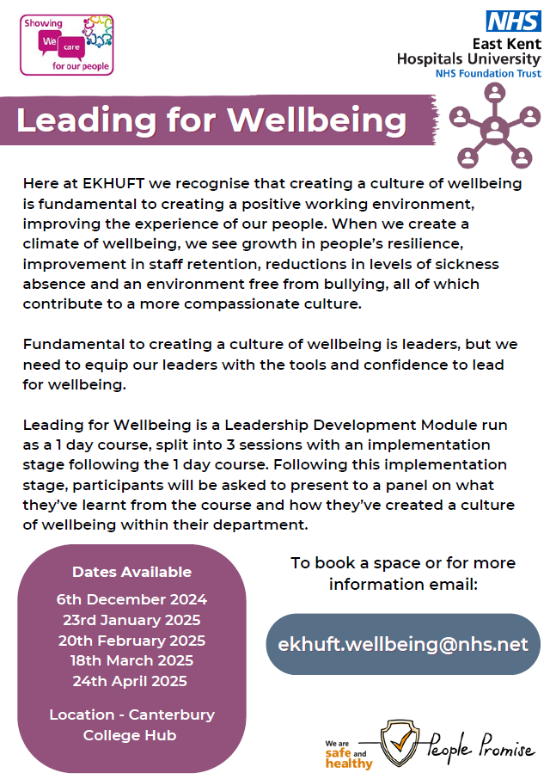
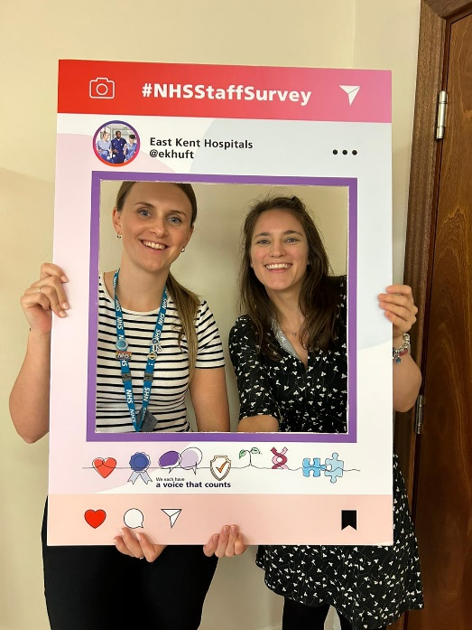
Wellbeing Conversations – Next steps
Wellbeing Conversations – Next Steps
Continue to promote wellbeing conversations, particularly in hotspot areas.
To continue the focus on empowering staff, including training at least 25% of our organisation in some form of wellbeing advocacy/training.
To complete the development of our Wellbeing Dashboard, to better understand the benefits of wellbeing training, as well as the value of wellbeing advocacy to our organisation.
Using our new ‘Leading for Wellbeing’ course to build on the learnings from Wellbeing Conversations Training, equipping leaders with the tools needed to create a culture of wellbeing in their areas.

Slide 5
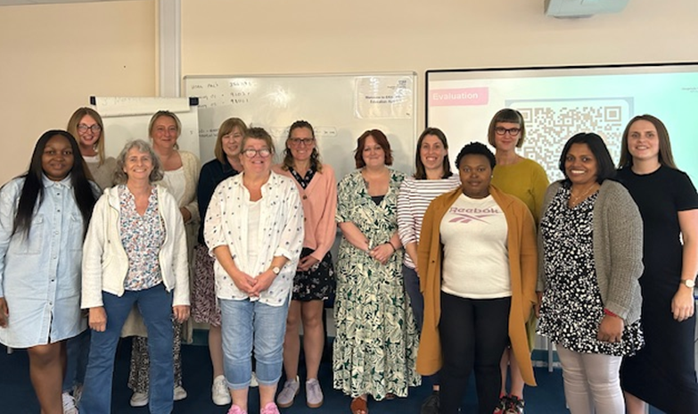
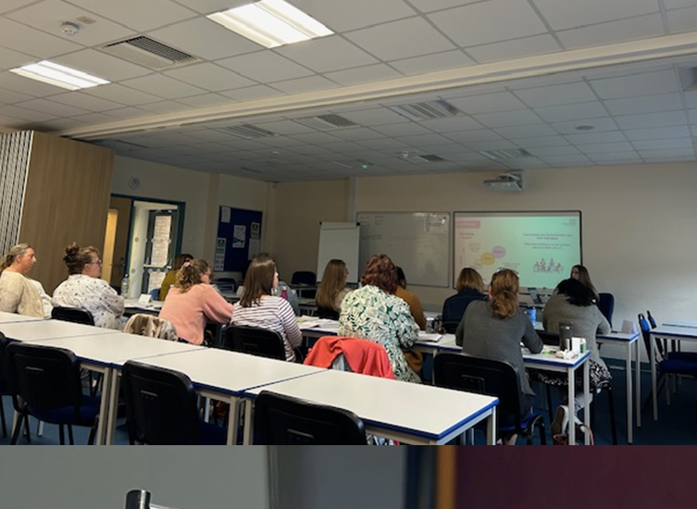
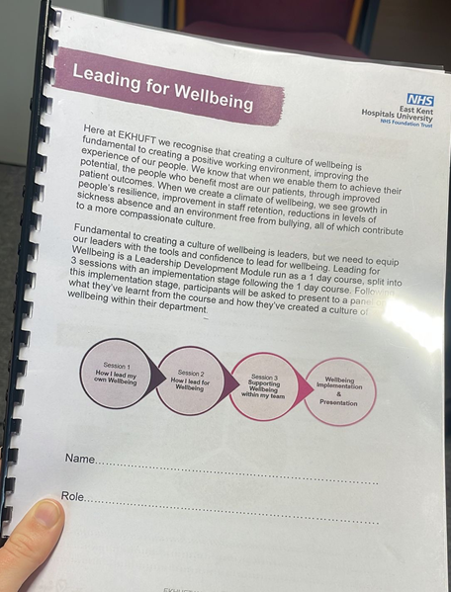
Introducing Leading for Wellbeing
Introducing Leading for Wellbeing
Developed following national leadership training, and an internal gap analysis, taking the national format and adapting it to our needs in East Kent.
The course was piloted with Wellbeing Advocates (e.g. Wellbeing Champions, Mental Health First Aiders and TRiM Practitioners/Managers) who hold leadership positions (2024) and officially rolled out in 2025, targeting ‘hotspot’ areas with the support of People & Culture (P&C) Business Partners.
The course is delivered as a one-day programme, covering three modules (leading my own wellbeing, how I lead for wellbeing, and supporting wellbeing within my team), followed by an implementation period, in which attendees embed one personal and one team wellbeing goal, before returning for a short presentation to a panel to complete the course.
We have trained 77 managers, who manage 1,265 staff members between them. Feedback suggests that the course has made a difference to both individuals and teams, and the implementation stage of the course has supported leaders to embed wellbeing into their teams.

Slide 6
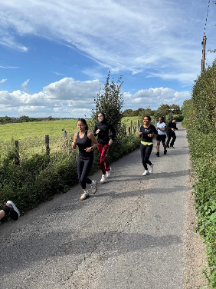

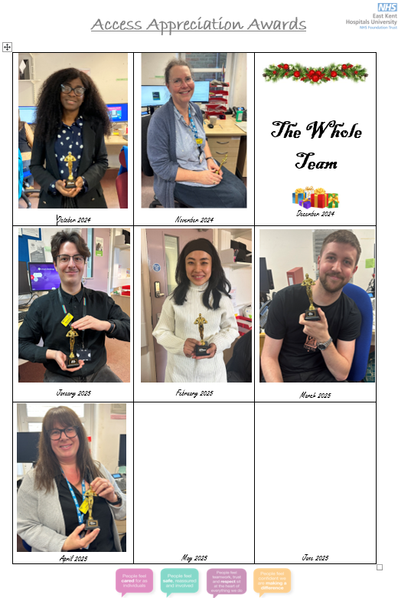
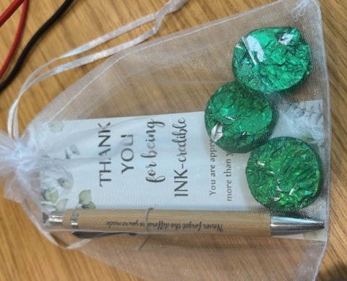
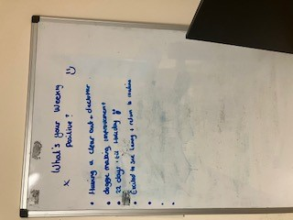
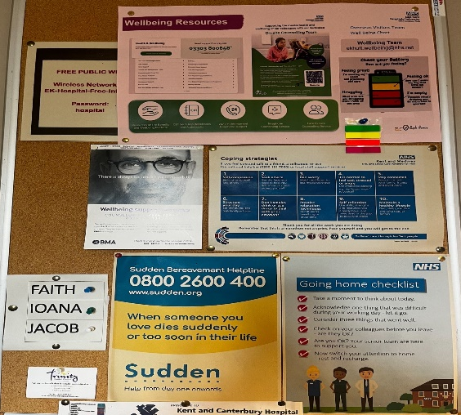
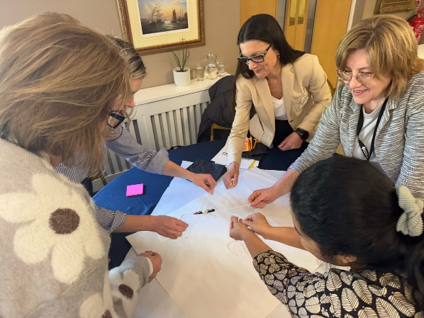
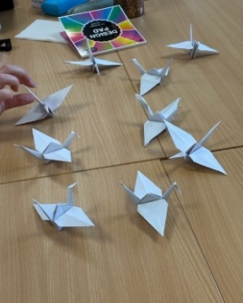
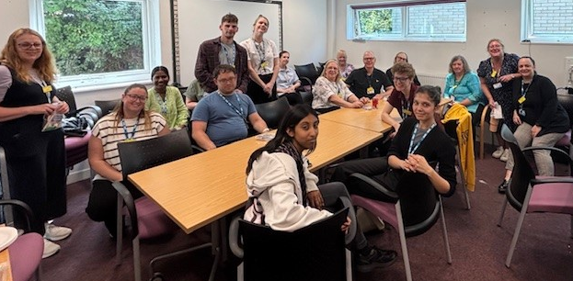
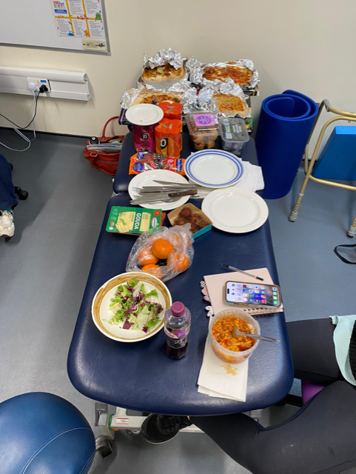
Leading for Wellbeing – Key Themes
Leading for Wellbeing – Key Themes
Key themes which have emerged as team goals have been: prioritising wellbeing check ins with staff, implementing visual wellbeing support (e.g. installing wellbeing boards), making time socially for team bonding, physical activity and healthy coping techniques as a team, and implementing appreciation activities and opportunities.
Key themes which have emerged as personal goals have been: taking lunch breaks (or at minimum eating at lunchtime!), introducing physical activity and taking time to oneself.

Slide 7
Leading for Wellbeing - Feedback
Leading for Wellbeing – Feedback
‘I’m able to recognise the signs of burnout more easily, and also identify what takes me down that path so that I can put things in place early to help myself’
‘My participation in this course has enabled me to contribute in small but meaningful ways to initiating wellbeing conversations about what fostering a positive wellbeing culture truly entails’.
‘’I feel much more confident in my ability to assess my own wellbeing… I felt equipped to look after myself, but also to notice those impacts and assess my resilience.’
‘The impact has been knowing my capacity and only taking on what I am able to do. Taking time for myself and checking on my own wellbeing has helped me to become more relaxed and not feel so anxious’.
‘The course was eye opening, in particular for me to consider how to manage check ins throughout different and shifting teams’.
‘This has bled into my home life and I’ve lost weight and have more energy’.

